Slide 1
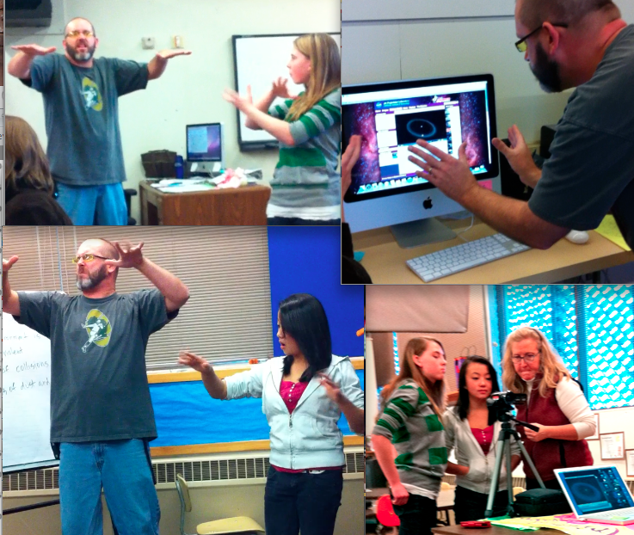
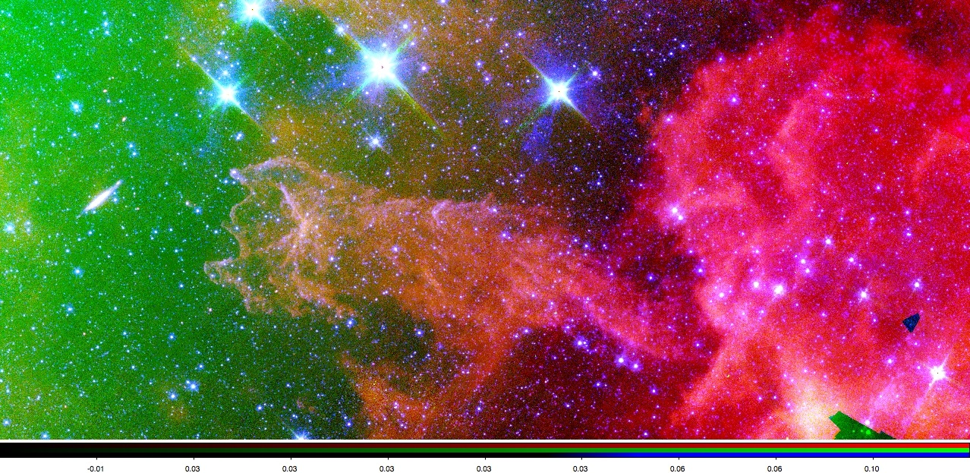
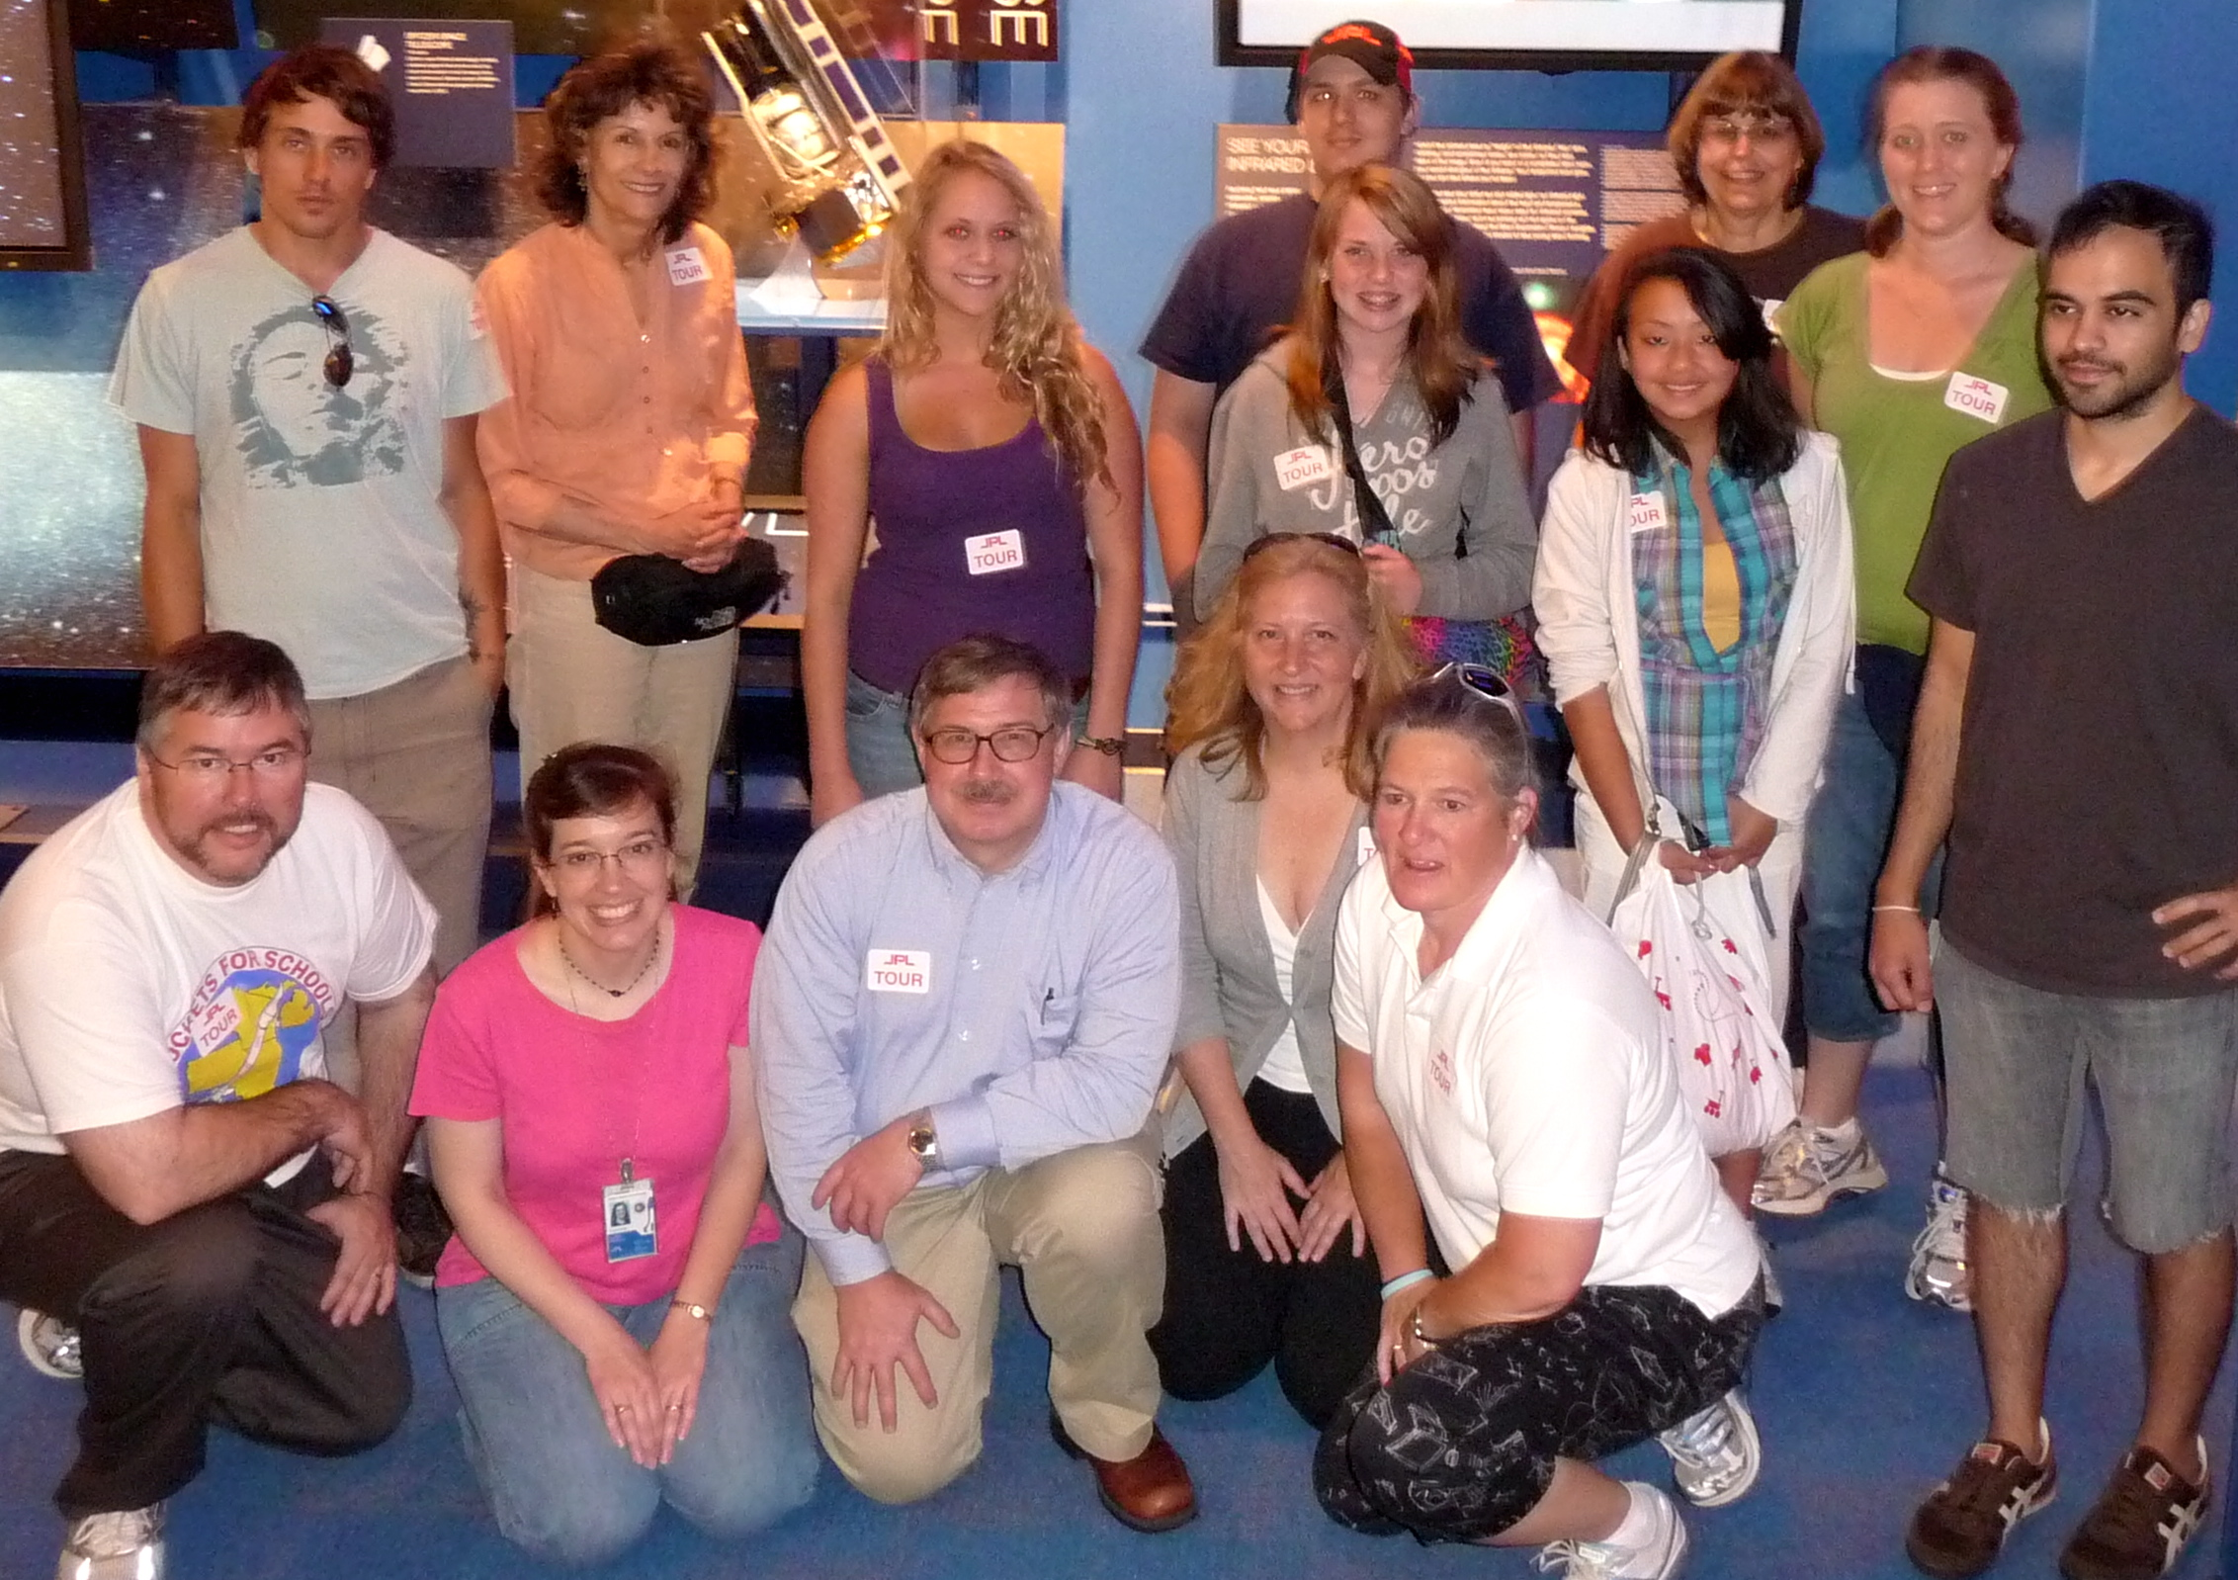
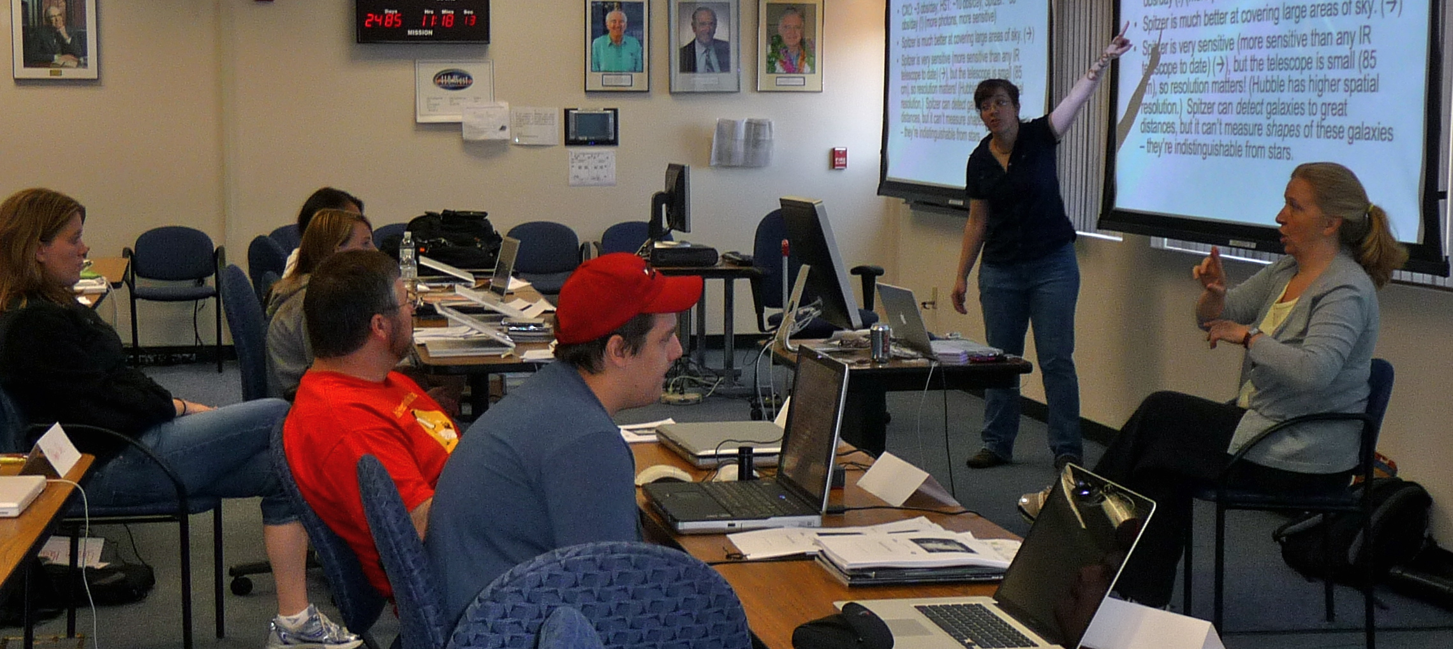
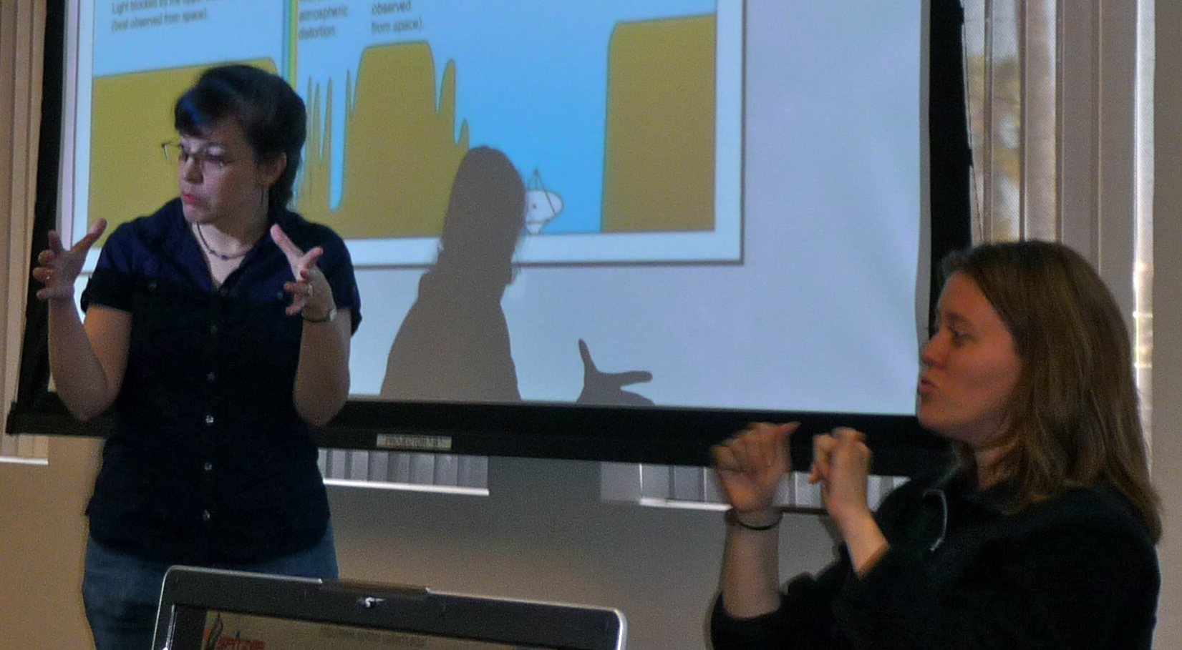
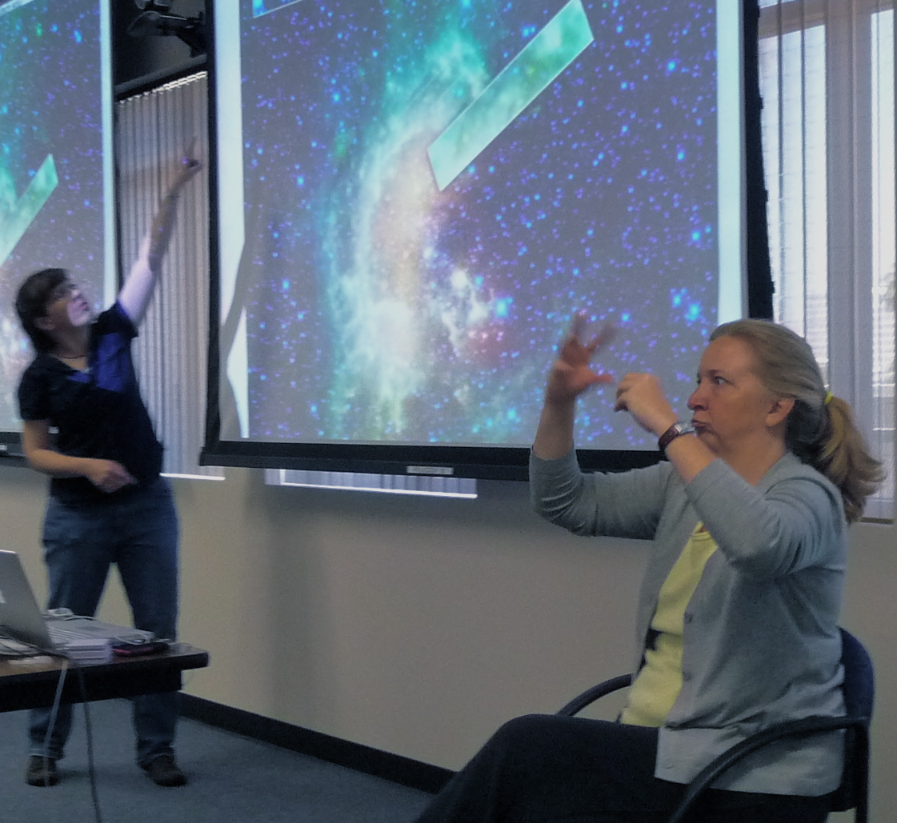
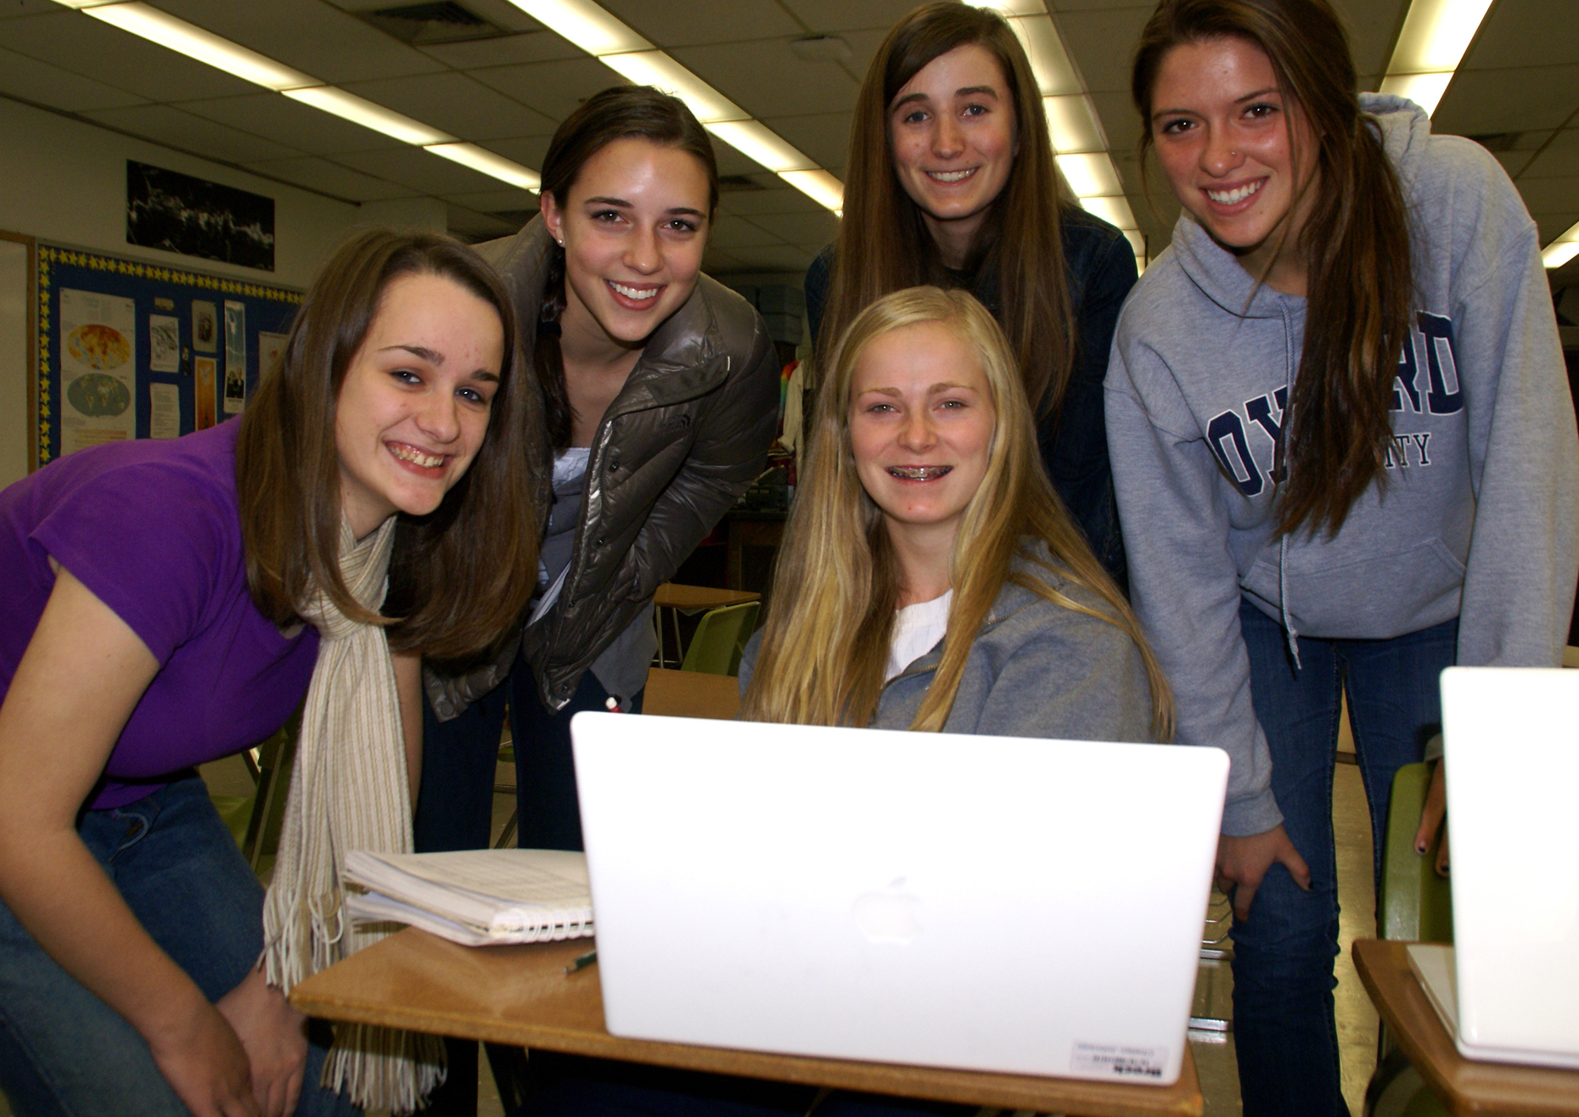
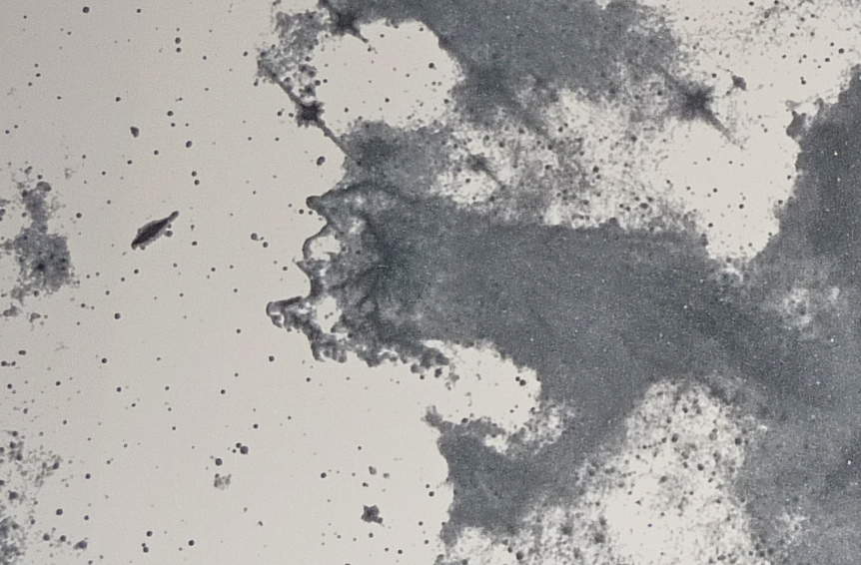
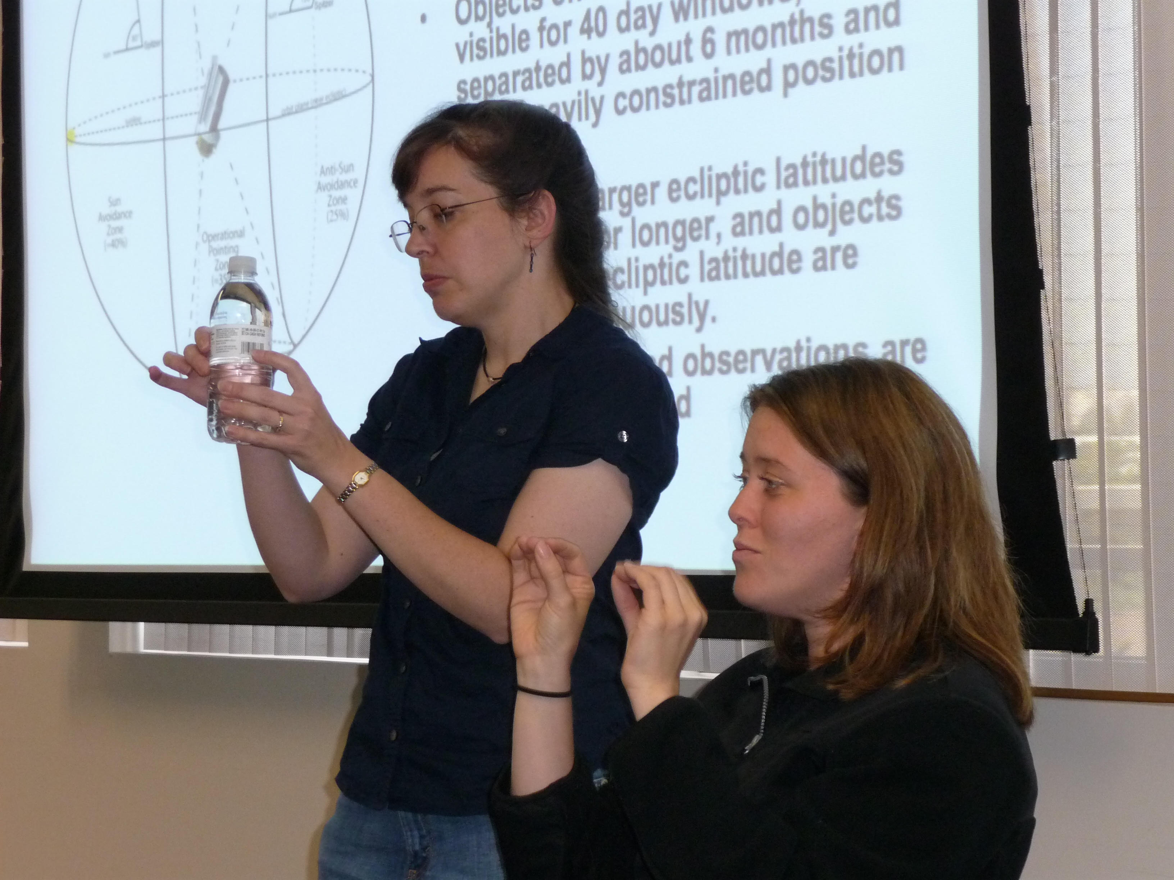
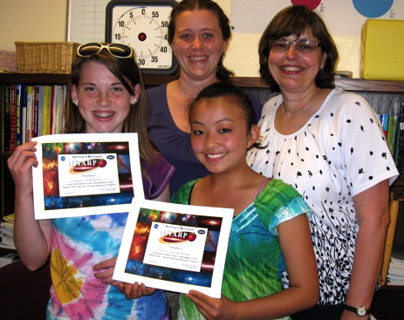
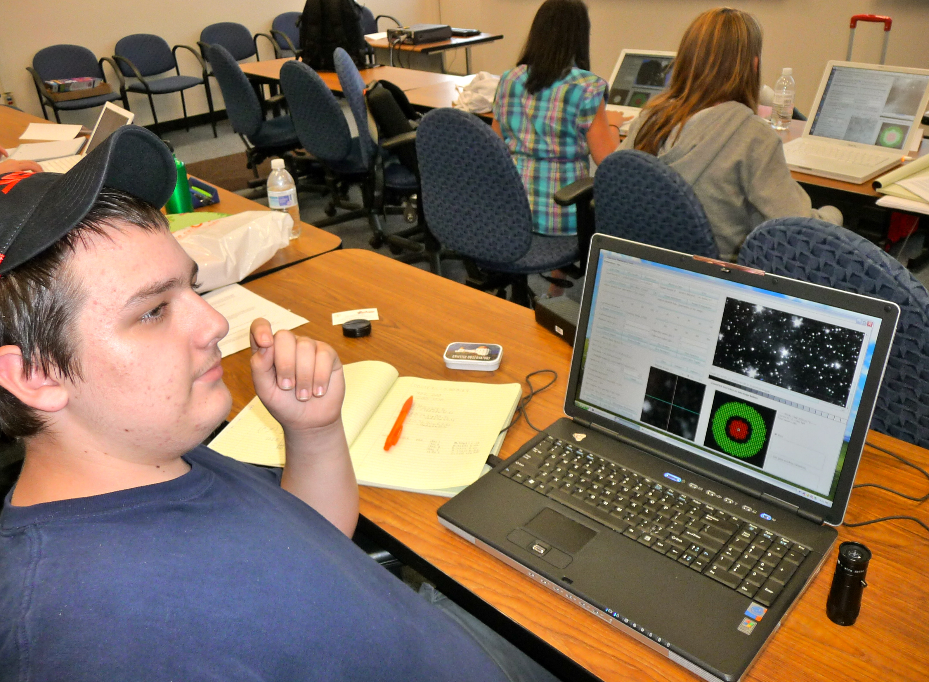
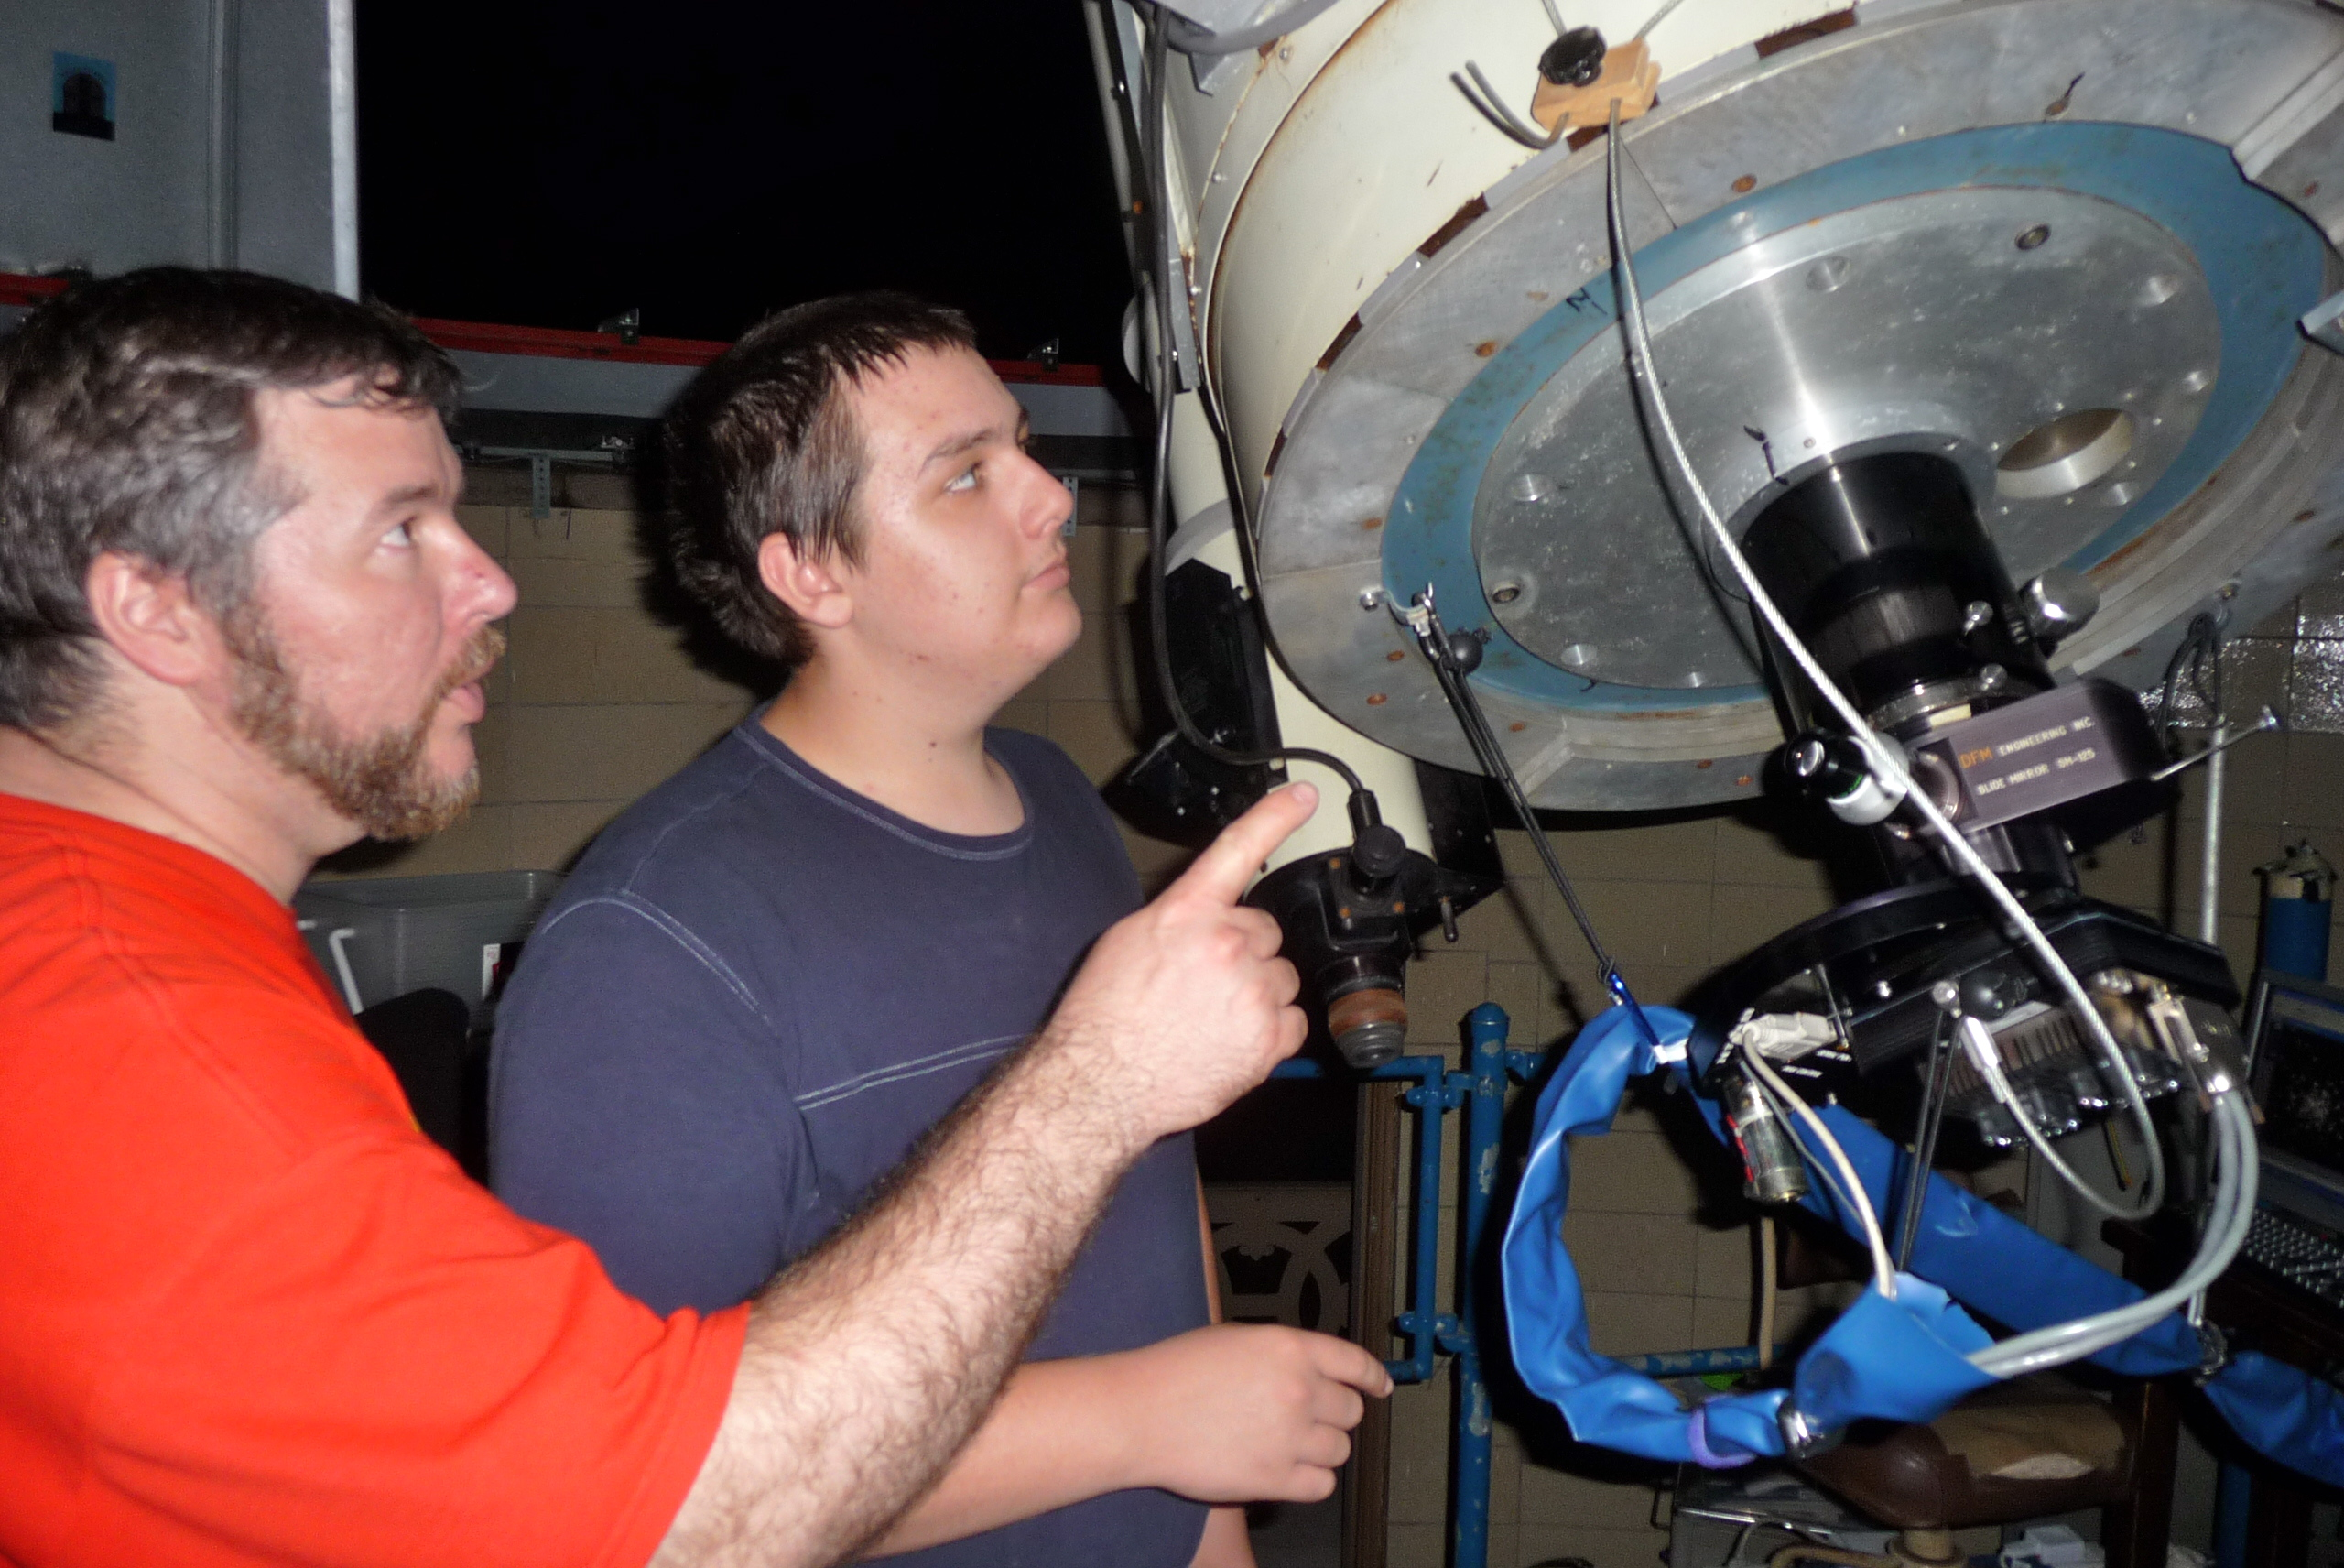
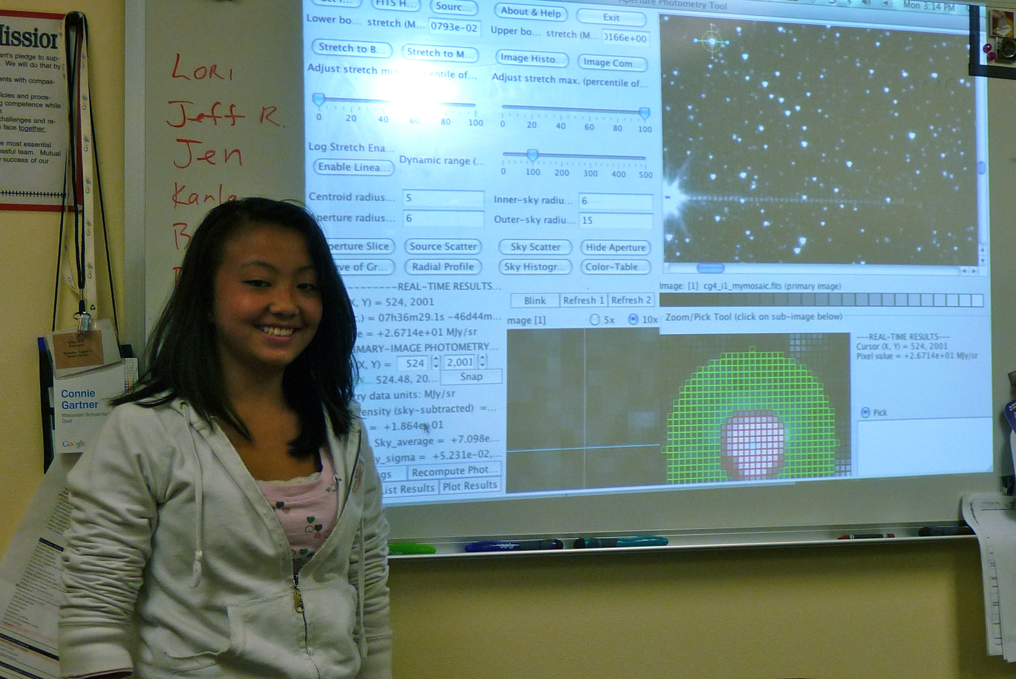
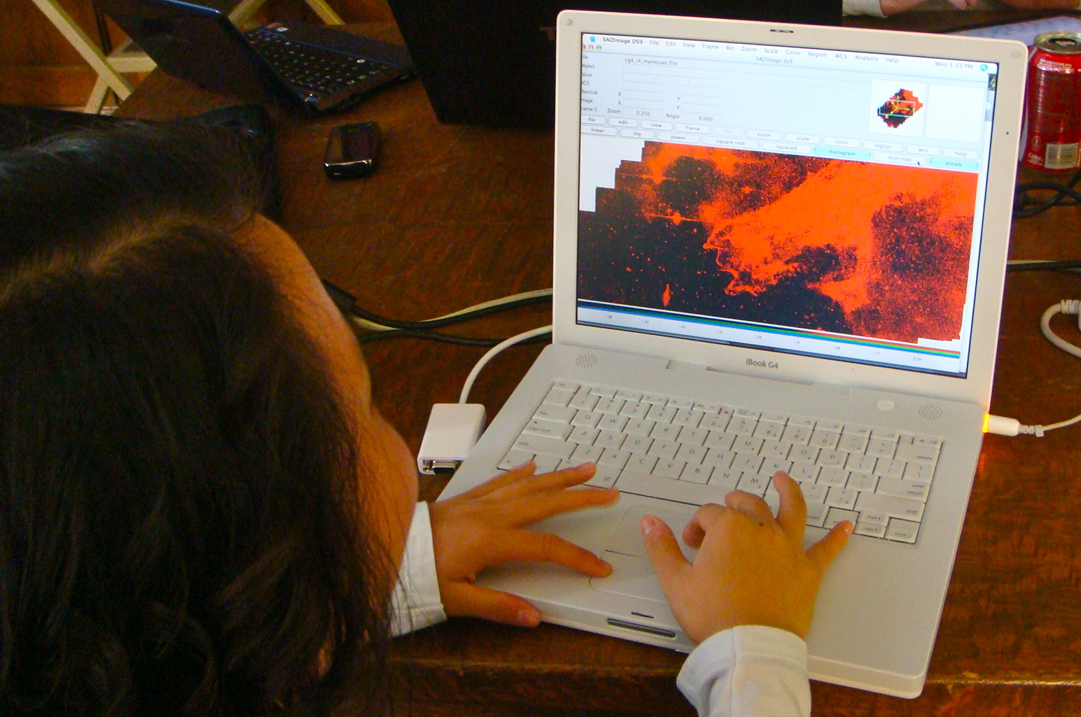
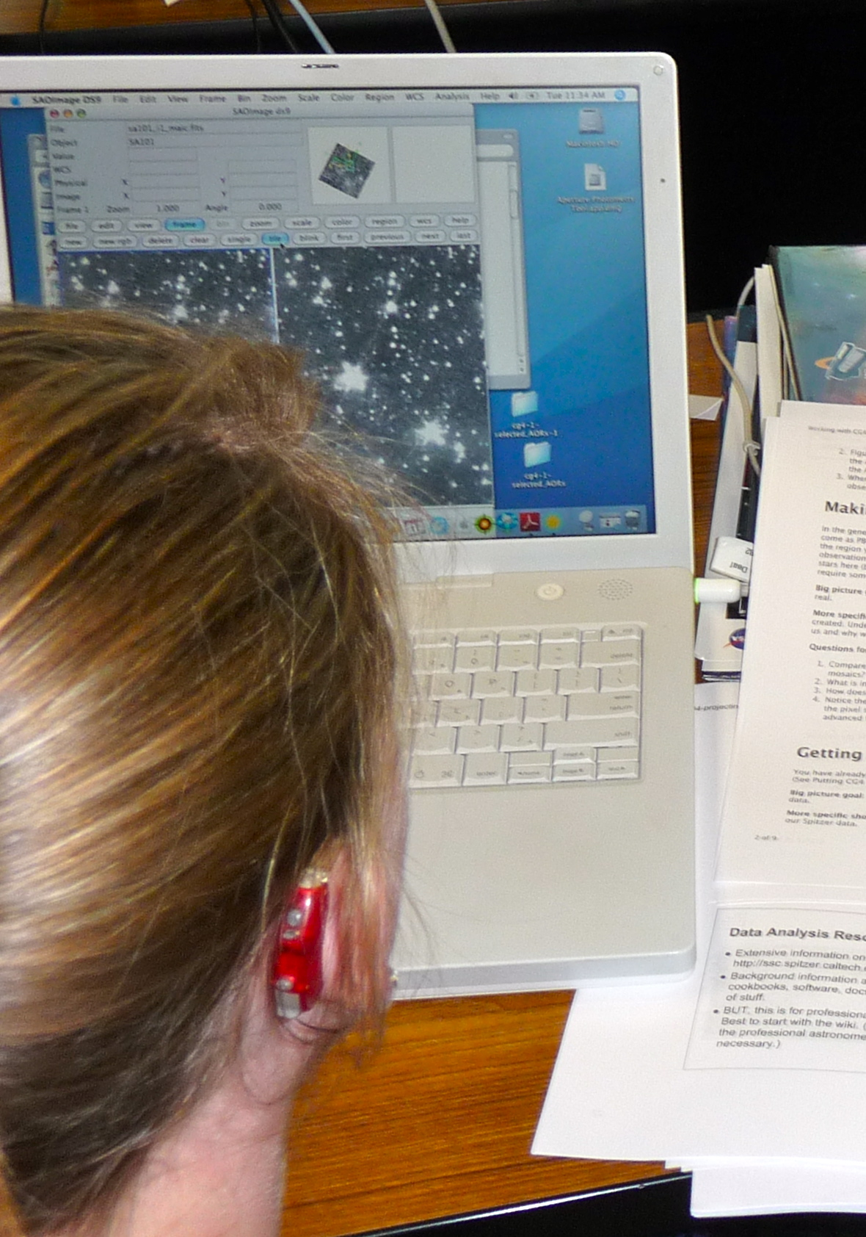
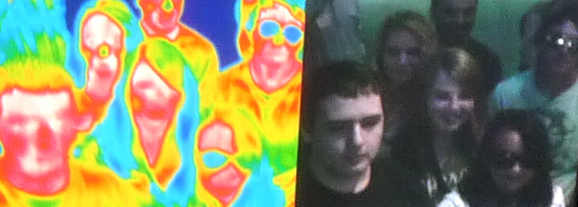
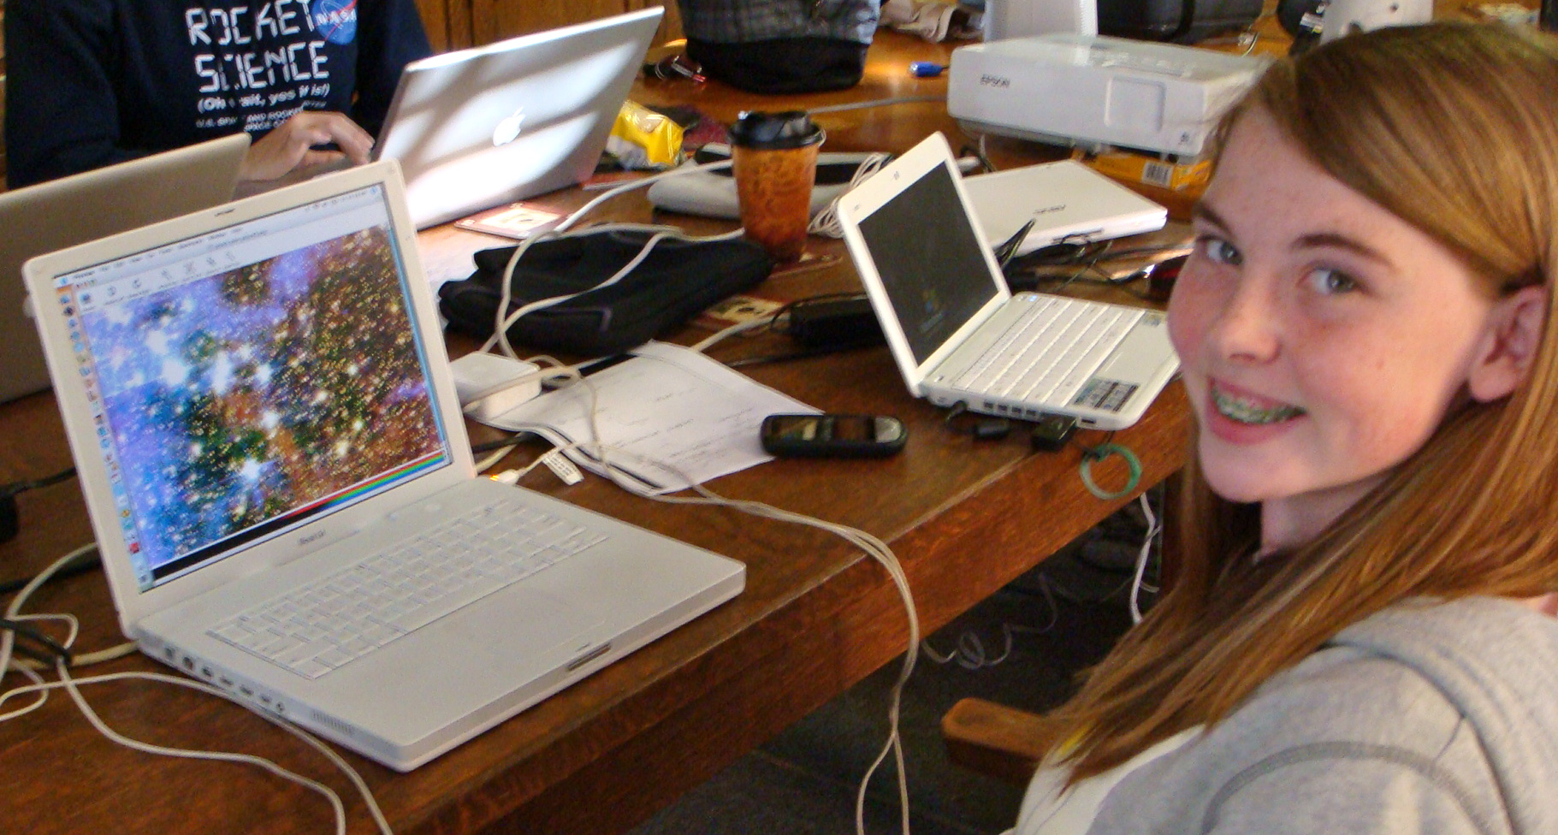
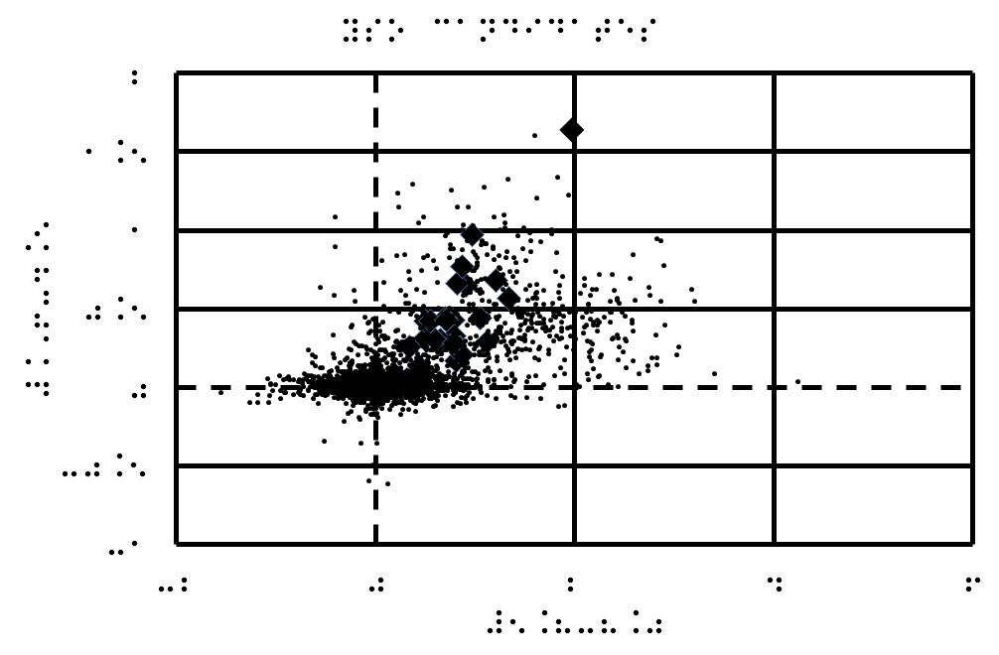
A Multi-Sensory Approach to Search for Young Stellar Objects in CG4
Project Participants: Vivian Hoette¹, Luisa Rebull², Kevin McCarron³, Chelen Johnson⁴, Connie Gartner⁵, Jen VanDerMolen⁵, Lee Gamble⁶, Lyssa Matsche⁵, Anna McCartney⁵, Mark Doering⁶, Rachel Crump⁴, Anna Killingstad⁴, Taylor McCanna⁴, Sally Caruso⁴, Anna Laorr⁴, Kayla Mork⁴, Emma Steinbergs⁴, Elizabeth Wigley⁴ ¹University of Chicago, Yerkes Observatory; ²SSC/IPAC/Caltech; ³Oak Park and River Forest High School; ⁴Breck School; ⁵Wisconsin School for the Deaf, ⁶Wisconsin Center for the Blind and Visually Impaired
Abstract Individuals with disabilities - specifically individuals who are deaf or hard of hearing (DHH) or blind or visually impaired (BVI) - are traditionally underrepresented in the STEM fields. Our goals are threefold; to engage DHH and BVI students with equal success as their sighted and hearing peers, to share our techniques in order to make astronomy more accessible to DHH and BVI youth, and to generate a life-long interest which will lead our students to STEM careers. Educators from Yerkes Observatory, the Wisconsin School for the Deaf (WSD), the Wisconsin Center for the Blind and Visually Impaired (WCBVI), Breck School, and Oak Park and River Forest High School (OPRFHS), are engaged in active research with Spitzer Space Telescope scientists within the NASA/IPAC Teacher Archive Research Project (NITARP). During the spring, summer, and fall of 2010, the group coauthored a poster on finding Young Stellar Objects (YSO) in the CG4 Nebula in Puppis using various techniques for engaging DHH and BVI students. We gratefully acknowledge funding from NITARP, SOFIA, NSF, Lions Clubs, and AAUW.
How do we accommodate blind and visually impaired (BVI) and deaf and hard of hearing (DHH) students learning astronomy?
Create an ASL video to narrate simulations.
Recognize expertise and promote leadership
WSD team specialized in visualization and three color images with DS9, created a “how to” manual; created ASL videos to explain NASA movie simulations of star and solar system formation.
WCBVI team researched Spitzer Telescope and created an Excel tool with control by keystrokes and macros for importing data, applying cuts, and creating plots; created tactile and embossed images.
Breck team analyzed mathematical data and checked photometry with Aperture Photometry Tool (APT); took the lead on the science poster 340.08 Searching for Young Stellar Objects in CG4
Include deaf and hard of hearing
ASL for Content
Provide competent American Sign Language (ASL) models for content knowledge
Create body of resources for future students
Students create multimedia projects
ASL Interpreters
Do not shy away from ‘dense’ terminology.
Fingerspell terminologies that do not have formal ASL signs
Video
Create and/or use available captioned videos
Communicate and collaborate (Skype, video relay interpreters
Include blind and visually impaired
Create tactile or embossed graphics
Audio files, text files of presentations, and alternative text for graphics and pictures
Overview and detailed descriptions of graphics, with emphasis on spatial relationships
Make software programs accessible with audio; control with keystrokes rather than relying on mouse clicks.
Allow and provide accommodating technology, such as screen readers, electronic or Braille notetakers, oculars.
Ask students what they need and use now.
Accommodate for BVI and DHH
(and every student)
Follow students' lead to adapt for learning styles and abilities
Encourage independence
Full participation in labs, multi-sensory setups
Hands-on STEM experiences
Access to mentors and role models
Listen and discuss, have high expectations
Encourage students to express their understanding of concepts and to describe observations, directions, routines, and processes from their unique perspective.
Create Tactile Graphics
As a teacher I have found that adapting my lessons for BVI has helped me understand the needs of all my students. - Lee Gamble
It’s cool, looking at the pictures, finding the stars. It’s like a game.
Conclusions
Science is possible for all students and everyone deserves the opportunity to reach their full potential.
Applying principles of universal design improves education for all students regardless of ability.
We must improve our language, technology, and leadership to give all students opportunities in science and astronomy.
Involving new voices enriches the field for everyone in the future.
We have found that beneficial accommodations for our Deaf students include: using sign language to communicate the information, providing a visual demonstration, showing images or short video clips, using a notetaker and allowing for ample time for hands-on work.
Making information and instruction more visual for Deaf students is vital to their education and understanding of new material. - Jen VanDerMolen
Braille and Big Dots on Plot
How to Make a Color Image in DS9 by students Lyssa and Anna. Open up SAOImage DS9. Click on “frame” then click “New RGB” (If needed, put the box out of the way so that you can always go right back to it when you are on your next picture.) Next, click on any color that you want from the RGB box. Click inside the DS9 box, then click “File”, then “Open”. Find “My mosaics”, then click to open any photo. Double click on the photo you choose and it will open on DS9. Once it has opened, click on Scale”, then click on “Histogram”. Now you need to go back to the RGB box and choose another color. Repeat steps 4-7 for the last 2 colors. (Remember, the images can’t be the same you used previously.) All colors Red, Green, and Blue should be covering each other. Now you have your color photo! If you want to adjust the colors, you can! All you have to do (on a Mac) is to click on a color from the RGB box, then go down to where there is a row of the colors on the bottom of the color picture. Then, click and hold the “Apple” button and the mouse button at the same time. Move the color bar side to side to change the color from visible to invisible. Repeat with the other 2 colors.

