Slide 1
10 SEDs to Train Your Eye

Slide 2
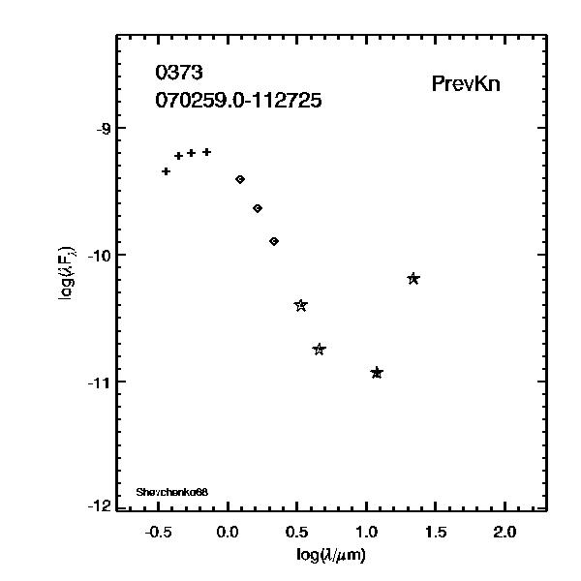
Basic Information
Internal number: 373
Catalog number: 070259.0-112725
Any other name: Shevchenko68
Why we care about this one: PrevKn
SED
+ or * = optical, diamonds=2MASS JHK, stars = WISE (3.4, 4.6, 12, 22 um) circles=IRAC (3.6, 4.5, 5.8, 8 microns), squares=MIPS (24, 70 microns) vertical bars are error bars

Slide 3
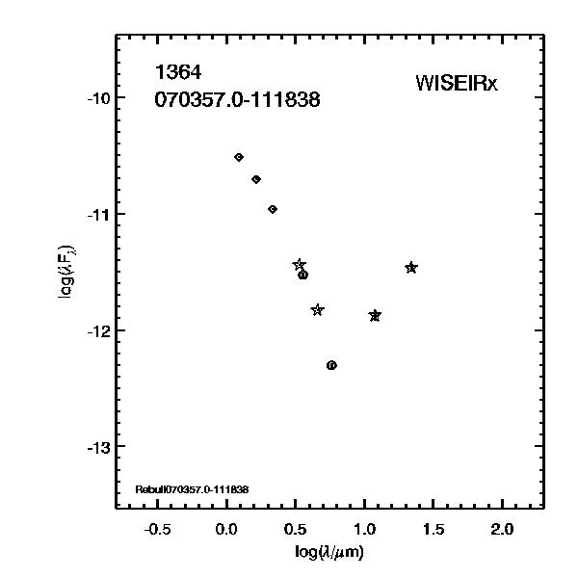
Basic Information
Internal number: 1364
Catalog number: 070357.0-111838
Any other name: Rebull070357.0-111838
Why we care about this one: WISEIRx
SED
+ or * = optical, diamonds=2MASS JHK, stars = WISE (3.4, 4.6, 12, 22 um) circles=IRAC (3.6, 4.5, 5.8, 8 microns), squares=MIPS (24, 70 microns) vertical bars are error bars

Slide 4
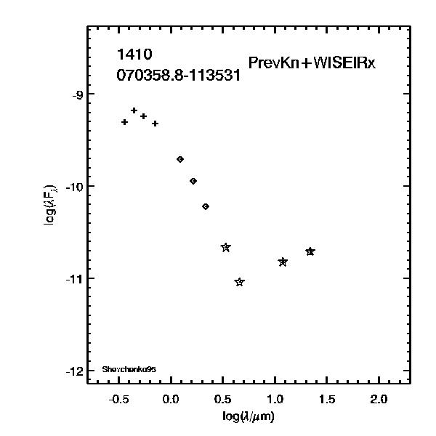
Basic Information
Internal number: 1410
Catalog number: 070358.8-113531
Any other name: Shevchenko95
Why we care about this one:
PrevKn+WISEIRx
SED
+ or * = optical, diamonds=2MASS JHK, stars = WISE (3.4, 4.6, 12, 22 um) circles=IRAC (3.6, 4.5, 5.8, 8 microns), squares=MIPS (24, 70 microns) vertical bars are error bars

Slide 5
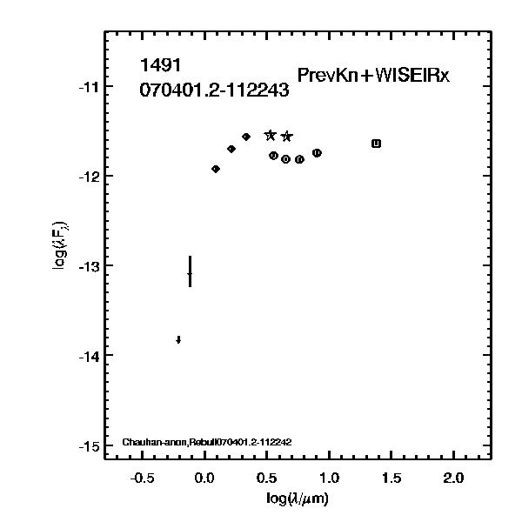
Basic Information
Internal number: 1491
Catalog number: 070401.2-112243
Any other name: Chauhan-anon,
Rebull070401.2-112242
Why we care about this one:
PrevKn+WISEIRx
SED
+ or * = optical, diamonds=2MASS JHK, stars = WISE (3.4, 4.6, 12, 22 um) circles=IRAC (3.6, 4.5, 5.8, 8 microns), squares=MIPS (24, 70 microns) vertical bars are error bars

Slide 6
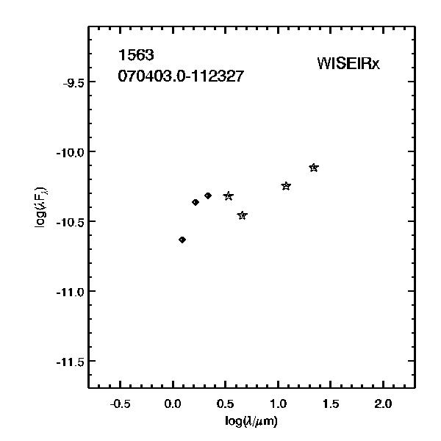
Basic Information
Internal number: 1563
Catalog number: 070403.0-112327
Any other name:
Why we care about this one: WISEIRx
SED
+ or * = optical, diamonds=2MASS JHK, stars = WISE (3.4, 4.6, 12, 22 um) circles=IRAC (3.6, 4.5, 5.8, 8 microns), squares=MIPS (24, 70 microns) vertical bars are error bars
Notes:
b

Slide 7
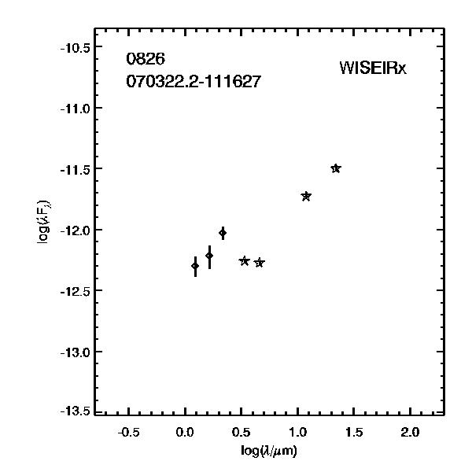
Basic Information
Internal number: 826
Catalog number: 070322.2-111627
Any other name:
Why we care about this one: WISEIRx
SED
+ or * = optical, diamonds=2MASS JHK, stars = WISE (3.4, 4.6, 12, 22 um) circles=IRAC (3.6, 4.5, 5.8, 8 microns), squares=MIPS (24, 70 microns) vertical bars are error bars

Slide 8
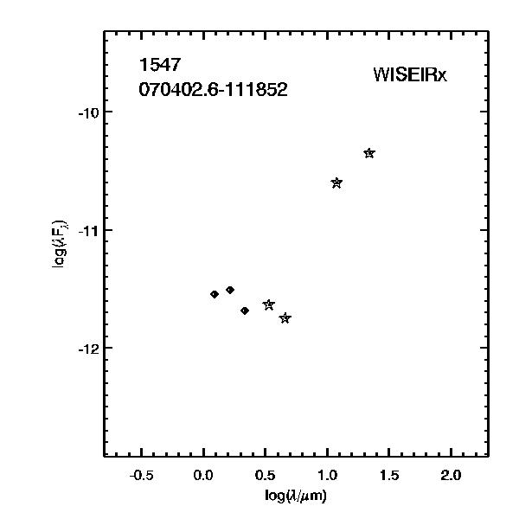
Basic Information
Internal number: 1547
Catalog number: 070402.6-111852
Any other name:
Why we care about this one: WISEIRx
SED
+ or * = optical, diamonds=2MASS JHK, stars = WISE (3.4, 4.6, 12, 22 um) circles=IRAC (3.6, 4.5, 5.8, 8 microns), squares=MIPS (24, 70 microns) vertical bars are error bars

Slide 9
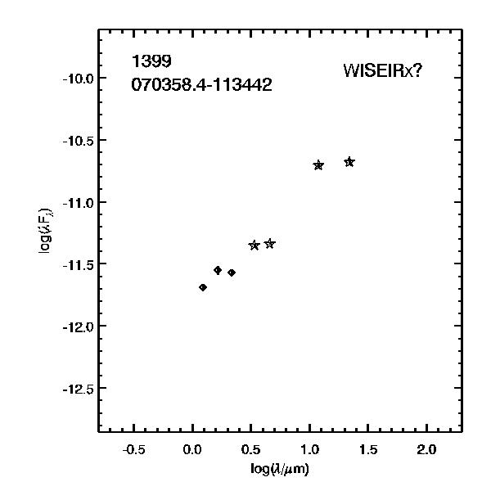
Basic Information
Internal number: 1399
Catalog number: 070358.4-113442
Any other name:
Why we care about this one: WISEIRx?
SED
+ or * = optical, diamonds=2MASS JHK, stars = WISE (3.4, 4.6, 12, 22 um) circles=IRAC (3.6, 4.5, 5.8, 8 microns), squares=MIPS (24, 70 microns) vertical bars are error bars

Slide 10
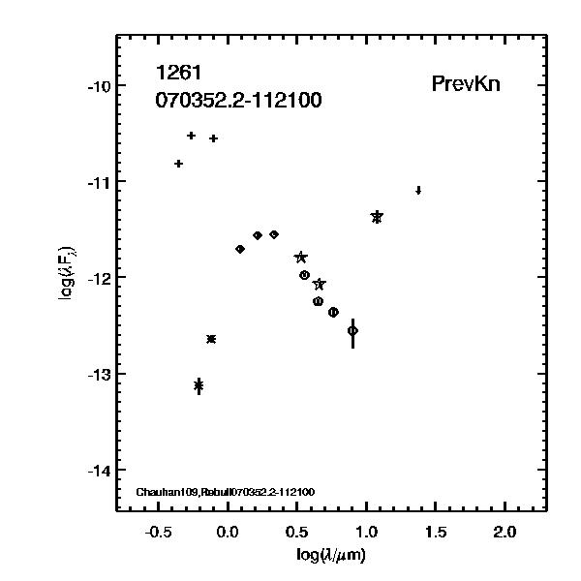
Basic Information
Internal number: 1261
Catalog number: 070352.2-112100
Any other name: Chauhan109,
Rebull070352.2-112100
Why we care about this one: PrevKn
SED
+ or * = optical, diamonds=2MASS JHK, stars = WISE (3.4, 4.6, 12, 22 um) circles=IRAC (3.6, 4.5, 5.8, 8 microns), squares=MIPS (24, 70 microns) vertical bars are error bars

Slide 11
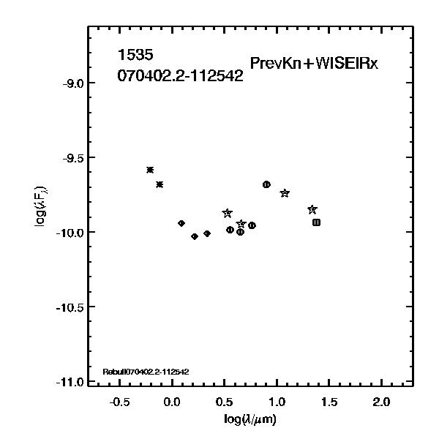
Basic Information
Internal number: 1535
Catalog number: 070402.2-112542
Any other name: Rebull070402.2-112542
Why we care about this one: PrevKn+WISEIRx
SED
+ or * = optical, diamonds=2MASS JHK, stars = WISE (3.4, 4.6, 12, 22 um) circles=IRAC (3.6, 4.5, 5.8, 8 microns), squares=MIPS (24, 70 microns) vertical bars are error bars

