Slide 1
New Young Stars (both human & astronomical) in the Gum Nebula
Mark Legassie
Spitzer Science Center
GISS 2011

Slide 2
WHY IS I&T HERE?
SERENDIPITOUSLY…
IPAC has great EPO programs to encourage kids and adults to become interested in science
Heard the term ‘NITARP’ many times & knew it involved teaching
Sounded less than interesting & never got involved
Wondered if the “A” stood for “apple”?
Then a change of heart – in 2010 volunteered to to help with on-site seminars for the NASA/IPAC Teacher Archive Research Program
computer & network support
scientific application support
Got “hooked” on the science unexpectedly
Expanded into research role and contributor
Culminated with trip to AAS & as a co-author of a scientific paper for the first time in my life!
Unforeseen sense of accomplishment
AAS was a real GBE (goose-bump event)
Result? Re-energized & enthusiastic about my job

Slide 3
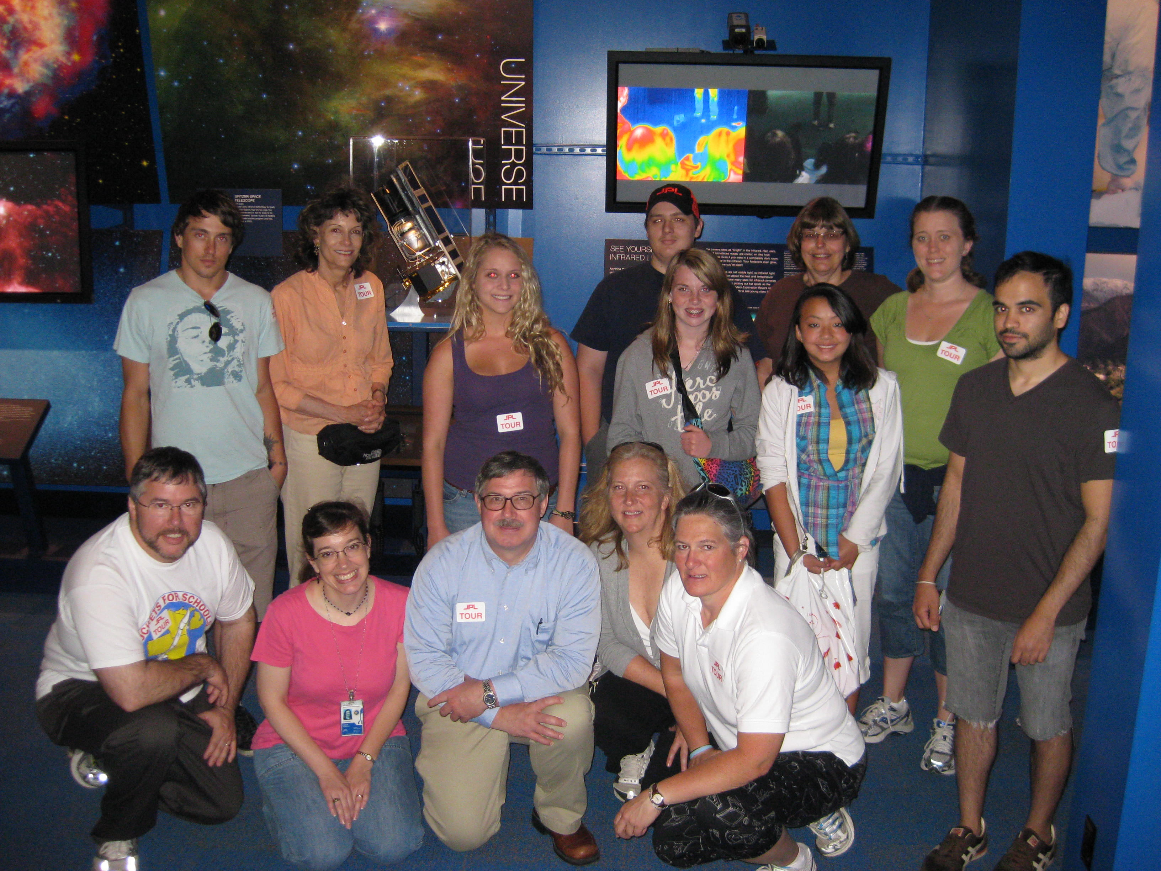
NITARP Team 2010 – JPL Tour, Summer 2010
NITARP GOAL
Inspire and motivate students to pursue careers in science, technology, engineering and mathematics
2010 PROJECT
LOOK FOR NEW YOUNG STELLAR OBJECTS (YSOs) IN
THE GUM NEBULA
NITARP’s trusted leader – Luisa Rebull!
NASA/IPAC TEACHER ARCHIVE RESEARCH PROGRAM (NITARP)
NITARP gets teachers involved in authentic astronomical research. It partners small groups of educators with a mentor professional astronomer for an original research project. The educators incorporate the experience into their classrooms and share their experience with other teachers.

Slide 4
NITARP TEAM 2010
4 Astronomer-Teacher teams (2 SSC & 2 NOAO)
9 posters presented at AAS meeting in Seattle (Jan 11)
Nearly 60 people affiliated with NITARP attending (~2% of meeting!)
Team working with Luisa Rebull (SSC):
Chelen Johnson ~ teacher mentor for team
Breck School, Minneapolis, MN
Kevin McCarron
Oak Park & River Forest High School, Oak Park, IL
Vivian Hoette
Yerkes Observatory, Williams Bay, WI
Carolyn Mallory
Pierce College, Woodland Hills, CA
Russ Laher
Spitzer Science Center, Pasadena, CA
Mark Legassie
Raytheon & Spitzer Science Center, Pasadena, CA

Slide 5
Most of the ~60
BONUS TRIVIA QUIZ– You have 5 seconds to find 2 familiar SSC faces and memorize their location in the picture (lower left, right rear, middle center, etc). KEEP YOUR ANSWERS QUIET!

Slide 6
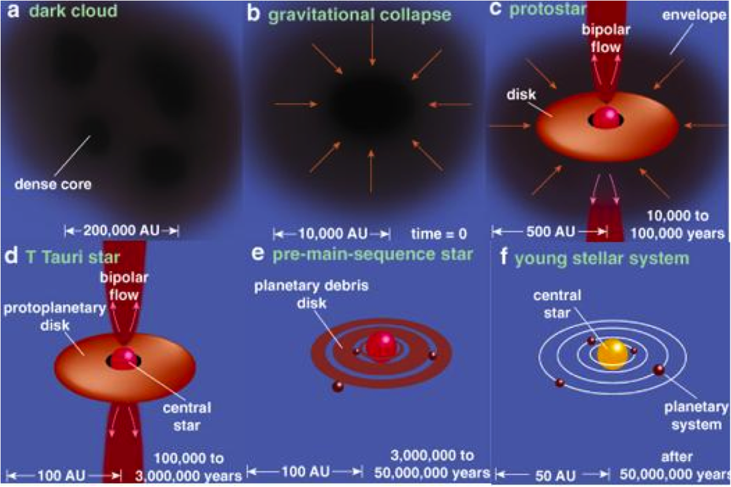
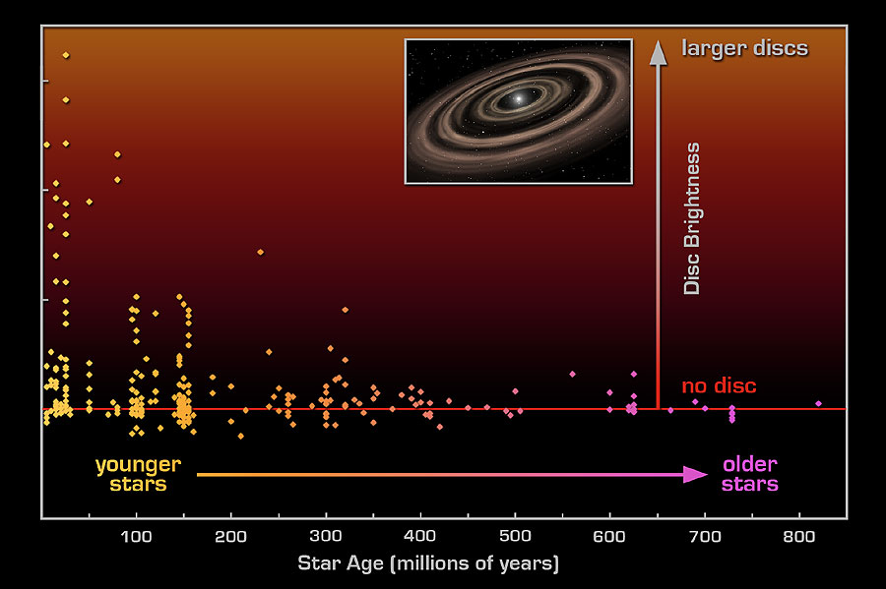
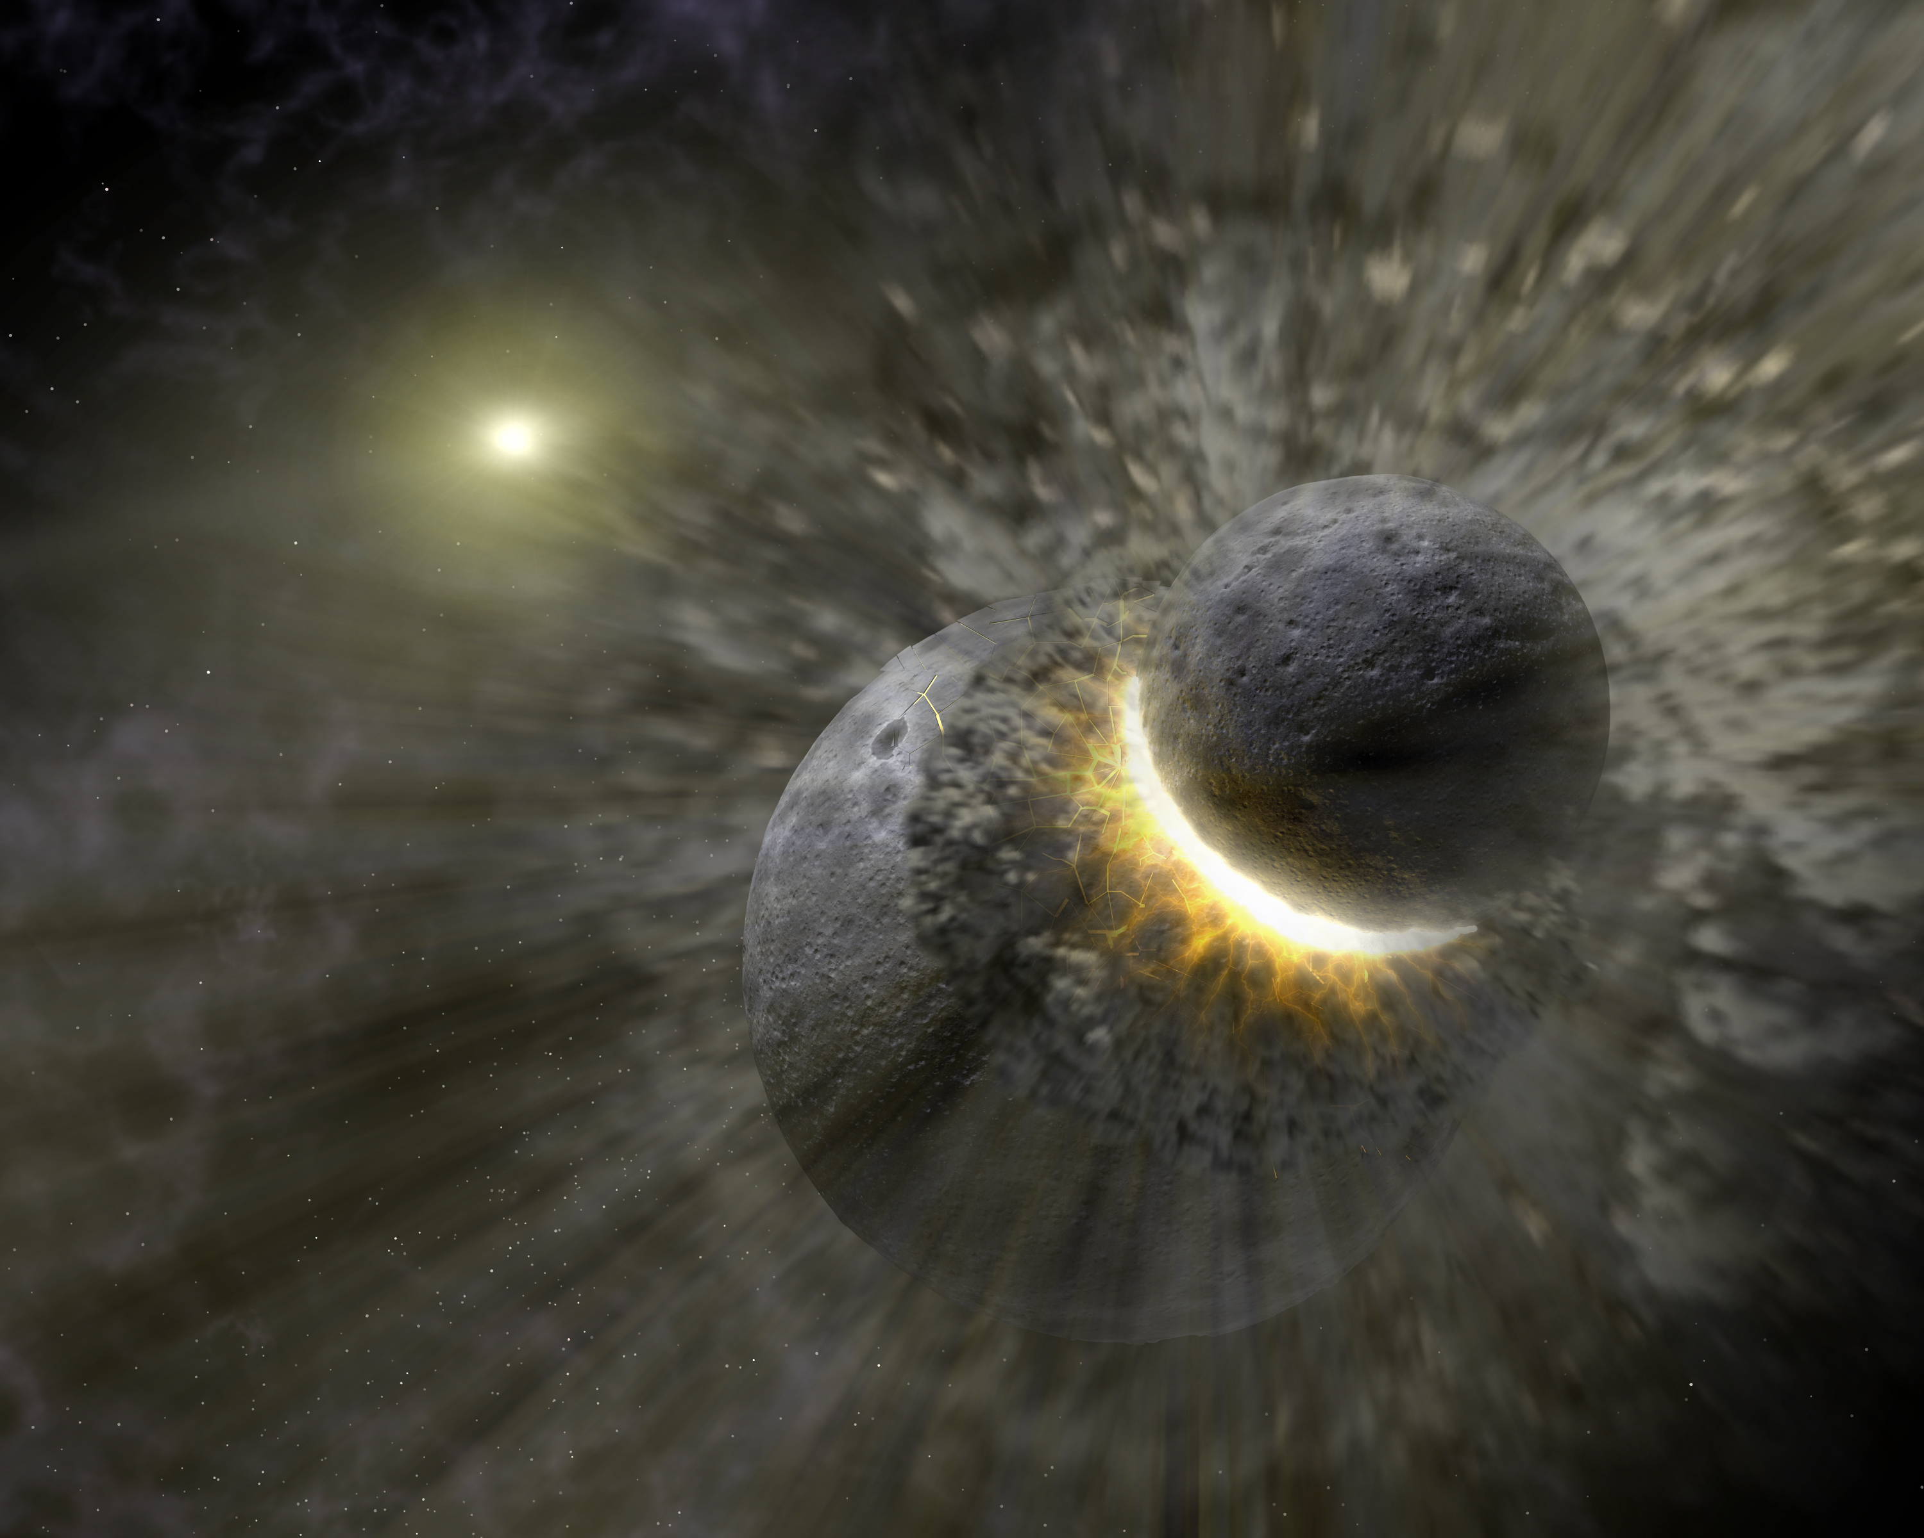
Debris disks
Stages of Low-Mass Star Formation
Disk Brightness vs Star’s Age
Class 0
Class I
Debris Disk Collisions
Class II
Class III
Class 0 = Main Accretion Phase? Class I = Late Accretion Phase? Class II = Optically Thick Disk Class III = Optically Thin Disk

Slide 8
Spectral Energy Distributions (SEDs) Reveal Disk Structure
Mid and Far-IR is sensitive to dust in the key planet-forming regions.
Far IR represents thermal dust emission.
Observations suggest the disk clears after a few million years.
-16
-17
λ F_{λ}
-18
Excess emission
over photosphere
-19
Photosphere
-20
1
10
100
1000
Wavelength (μm)
Slide from E. Young

Slide 9
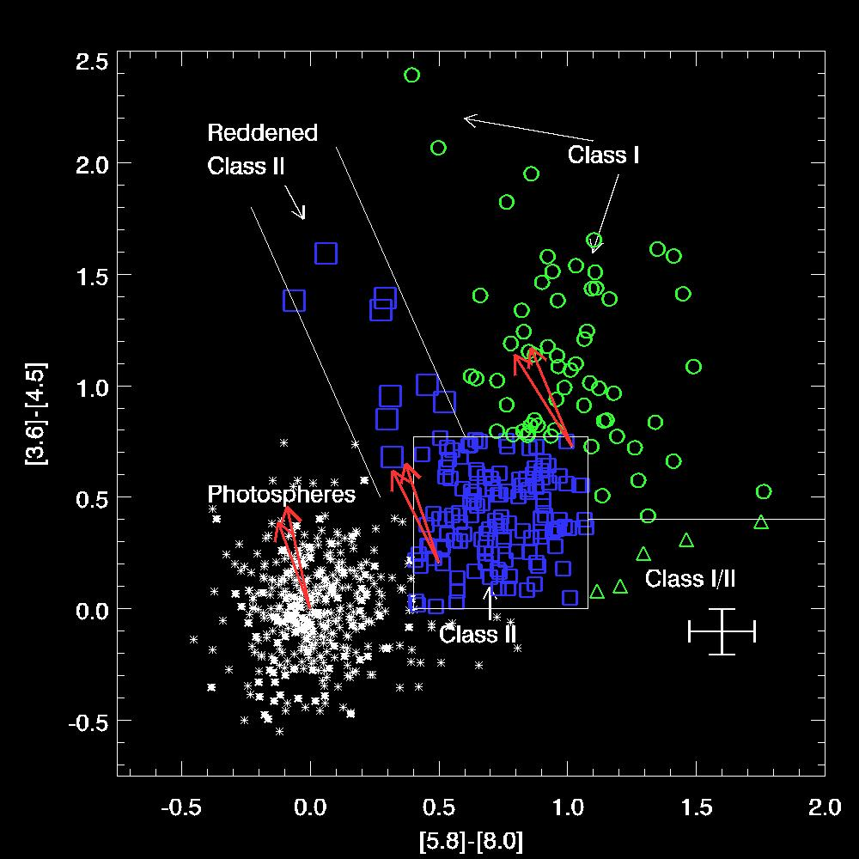
IRAC Color-Color Diagrams
Models aid in classification of objects as Class II (stars with disks) or Class I (protostars). Megeath et al. 2004*
Circles: Protostars
Squares:
star+disks
* We actually used Gutermuth 2008,2009 classifications

Slide 10
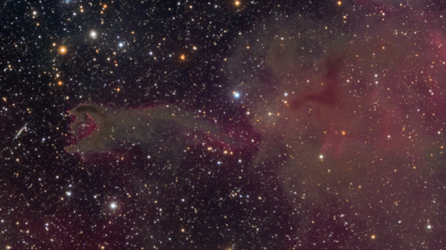
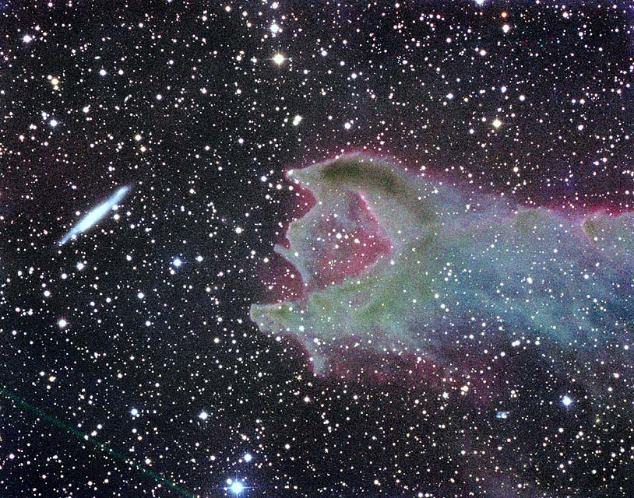
WHY GUM NEBULA?
CG4 – cometary globule
Dusty head
Elongated Tail
Area has previously-identified young stars (Reipurth & Pettersson 1993)
Lots of associated nebulosity
Suggests additional stars could be forming
SA101
Dec 2008; Riverland Dingo Observatory, Moorook, Australia
CG4
Oct 2002; Anglo-Australian Observatory, Coonabarabran Australia

Slide 11
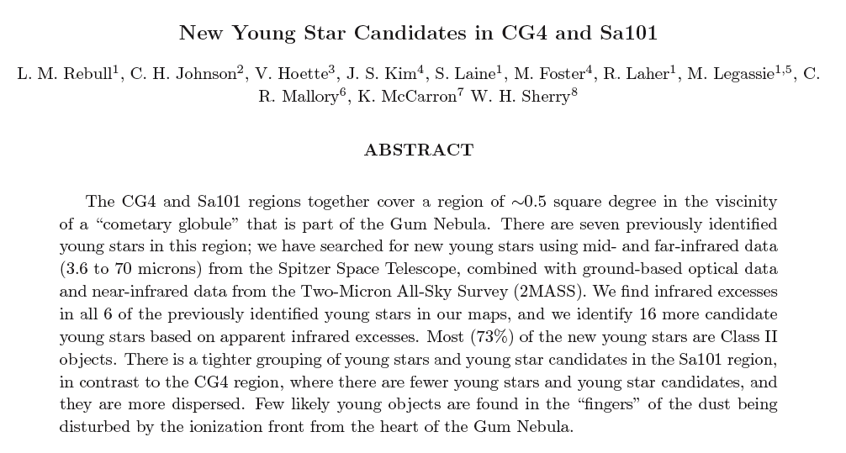
NITARP 2010
Rebull, L., et al., 2011, AJ, in press (arXiv 1105.1180)
Used archival infrared & optical data:
Spitzer IRAC
MIPS
2MASS
Optical
Focused on Infrared excesses
Location: http://arxiv.org/abs/1105.1180
Comments: Accepted for publication in AJ, May 5, 2011
Categories: astro-ph.SR
License: http://creativecommons.org/licenses/by/3.0/

Slide 12
DATA REDUCTION & ANALYSIS
CHRONOLOGICAL STEPS
Created mosaics using MOPEX
Investigated mosaics using DS9
Found previously known objects
Did photometry using APT
Constructed color-color & color-magnitude diagrams
Used Gutermuth IRAC-based color selection to identify initial sample of candidates
Generated Spectral Energy Distributions (SEDs)
Analyzed slope of SEDs & classified the objects
Investigated properties of YSO candidates using all available data, including:
Infrared excess
Brightness
UV excess
Spatial location
Association with nebulosity
SEDs of two new YSO candidates
Black crosses indicate optical data (B, V, R, I), grey circles indicate 2-MASS data (1.25, 1.65 and 2.17 µm); diamonds indicate Spitzer IRAC data (3.6, 4.5, 5.8, and 8.0 µm), and the red triangle indicates Spitzer MIPS data (24 µm).
SEDs of two new YSO candidates
Black crosses indicate optical data (B, V, R, I), grey circles indicate 2-MASS data (1.25, 1.65 and 2.17 µm); diamonds indicate Spitzer IRAC data (3.6, 4.5, 5.8, and 8.0 µm), and the red triangle indicates Spitzer MIPS data (24 µm).
SEDs of two new YSO candidates
Black crosses indicate optical data (B, V, R, I), grey circles indicate 2-MASS data (1.25, 1.65 and 2.17 µm); diamonds indicate Spitzer IRAC data (3.6, 4.5, 5.8, and 8.0 µm), and the red triangle indicates Spitzer MIPS data (24 µm).

Slide 13
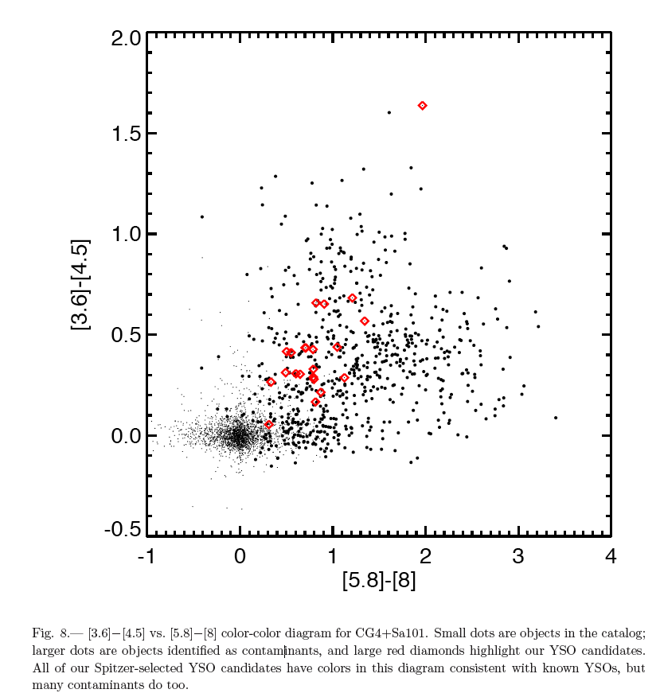
RESEARCH RESULTS
Color-Color Diagram
SEDs of two new YSO candidates
Black crosses indicate optical data (B, V, R, I), grey circles indicate 2-MASS data (1.25, 1.65 and 2.17 µm); diamonds indicate Spitzer IRAC data (3.6, 4.5, 5.8, and 8.0 µm), and the red triangle indicates Spitzer MIPS data (24 µm).
SEDs of two new YSO candidates
Black crosses indicate optical data (B, V, R, I), grey circles indicate 2-MASS data (1.25, 1.65 and 2.17 µm); diamonds indicate Spitzer IRAC data (3.6, 4.5, 5.8, and 8.0 µm), and the red triangle indicates Spitzer MIPS data (24 µm).
SEDs of two new YSO candidates
Black crosses indicate optical data (B, V, R, I), grey circles indicate 2-MASS data (1.25, 1.65 and 2.17 µm); diamonds indicate Spitzer IRAC data (3.6, 4.5, 5.8, and 8.0 µm), and the red triangle indicates Spitzer MIPS data (24 µm).

Slide 14
RESEARCH RESULTS
Spectral Energy Distributions
Spectral Energy Distributions (SEDs) and other tools were used to find 16 newly discovered young stars in CG4
Note 1: Dip In energy level due to inner disk hole (possibly due to planet clearing away debris)
Note 2: Curve showing infrared energy excess (above main sequence star black body) at longer wavelengths, which studies indicate a huge dusty disk around the new star is radiating lots of infrared radiation. CG-Ha2 is a rediscovered, previously known Young Stellar Object.

Slide 15
RESEARCH RESULTS
⬥
⬥
⬥
⬥
⬥
⬥
⬥
⬥
⬥
SEDs of two new YSO candidates
Black crosses indicate optical data (B, V, R, I), grey circles indicate 2-MASS data (1.25, 1.65 and 2.17 µm); diamonds indicate Spitzer IRAC data (3.6, 4.5, 5.8, and 8.0 µm), and the red triangle indicates Spitzer MIPS data (24 µm).
SEDs of two new YSO candidates
Black crosses indicate optical data (B, V, R, I), grey circles indicate 2-MASS data (1.25, 1.65 and 2.17 µm); diamonds indicate Spitzer IRAC data (3.6, 4.5, 5.8, and 8.0 µm), and the red triangle indicates Spitzer MIPS data (24 µm).
SEDs of two new YSO candidates
Black crosses indicate optical data (B, V, R, I), grey circles indicate 2-MASS data (1.25, 1.65 and 2.17 µm); diamonds indicate Spitzer IRAC data (3.6, 4.5, 5.8, and 8.0 µm), and the red triangle indicates Spitzer MIPS data (24 µm).
SEDs of two new YSO candidates
Black crosses indicate optical data (B, V, R, I), grey circles indicate 2-MASS data (1.25, 1.65 and 2.17 µm); diamonds indicate Spitzer IRAC data (3.6, 4.5, 5.8, and 8.0 µm), and the red triangle indicates Spitzer MIPS data (24 µm).
SEDs of two new YSO candidates
Black crosses indicate optical data (B, V, R, I), grey circles indicate 2-MASS data (1.25, 1.65 and 2.17 µm); diamonds indicate Spitzer IRAC data (3.6, 4.5, 5.8, and 8.0 µm), and the red triangle indicates Spitzer MIPS data (24 µm).

Slide 16
FINAL RESULTS
Our final results suggest 22 YSO candidates, 16 of which are completely new!
Among these 16 new YSO candidates, there are 10 of reasonably high-confidence, 2 mid-grade confidence, and 4 low-grade confidence.
Of the complete set of 22, there are 3 Class I candidates, 16 Class II candidates, 3 flat candidates, and 0 class III candidate.

Slide 17
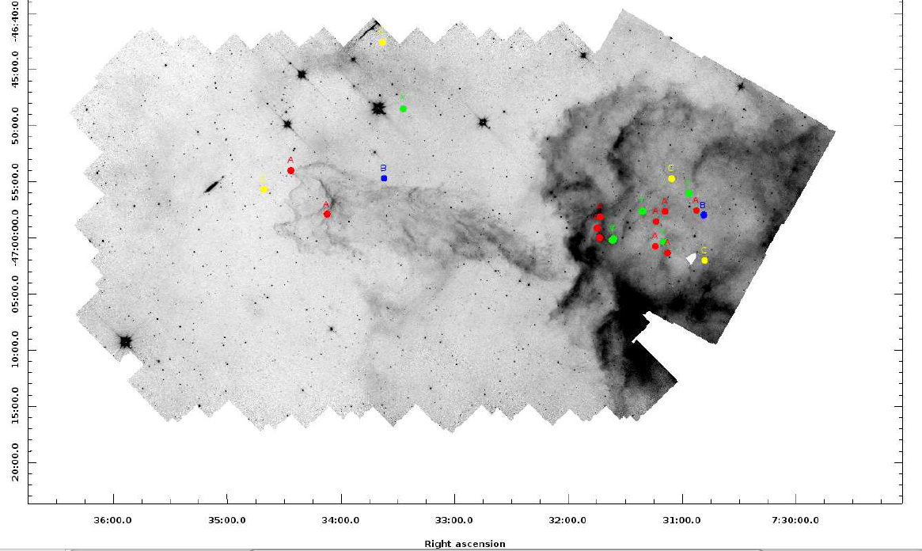
YSO CANDIDATES
IRAC-4 (8 µm) image with YSO candidates highlighted by grade (previously known YSO="Y” [green], then A [red], B [blue], C [yellow] in order from highest to lowest confidence).

Slide 18
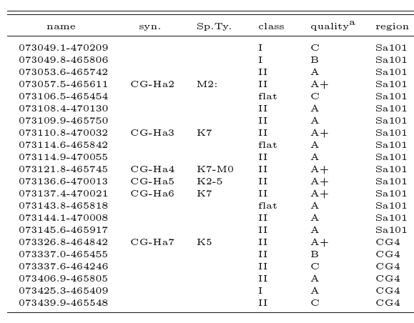
FINAL RESULTS
Final List of YSO Candidates in CG4+Sa101 regions

Slide 19
CONFIRMATION
Follow-up classification spectra will be required to confirm or reject our YSO candidates.

Slide 20
ANSWERS TO QUIZ
Varoujan Gorjian
Louisa Rebull
Mark Abajian
BONUS TRIVIA QUIZ– You have 5 seconds to find 2 familiar SSC faces and memorize their location in the picture (lower left, right rear, middle center, etc). KEEP YOUR ANSWERS QUIET!

Slide 21
UNIVERSE IS EXPANDING
Students wrote (and starred in) videos about star formation for those who have not heard

Slide 22
FINAL THOUGHTS
Discovering something new is powerful to the first-time researcher
NITARP makes students inspired and excited about astronomy, and science in general
Co-authoring and publishing a scientific paper is HUGE to young students and first-timers like I&T!
Watching the proud look on students as they answered questions about their AAS posters left a lasting impression on many
Saw it with my own eyes …
NITARP is turning students into young stars

Slide 23
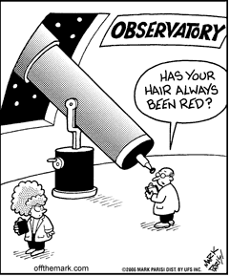
The End
Mark Legassie
Spitzer Science Center
GISS 2011

